Slide 1
The dsPIC33EP256GM710
A Breadboarding adventure!

Slide 2
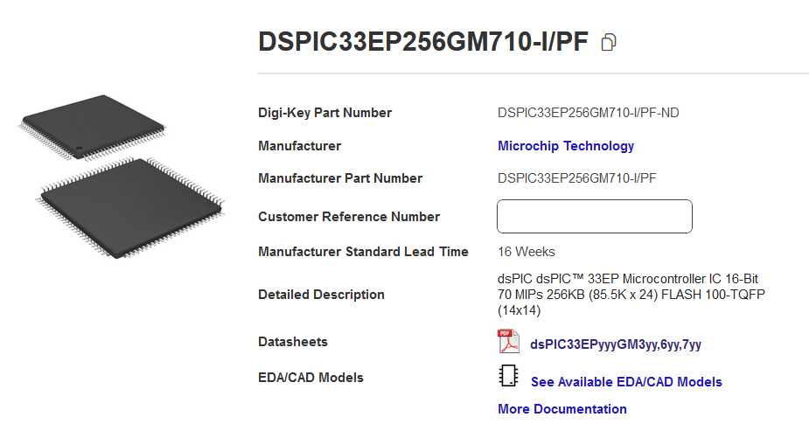
Available on Digikey!

Slide 3
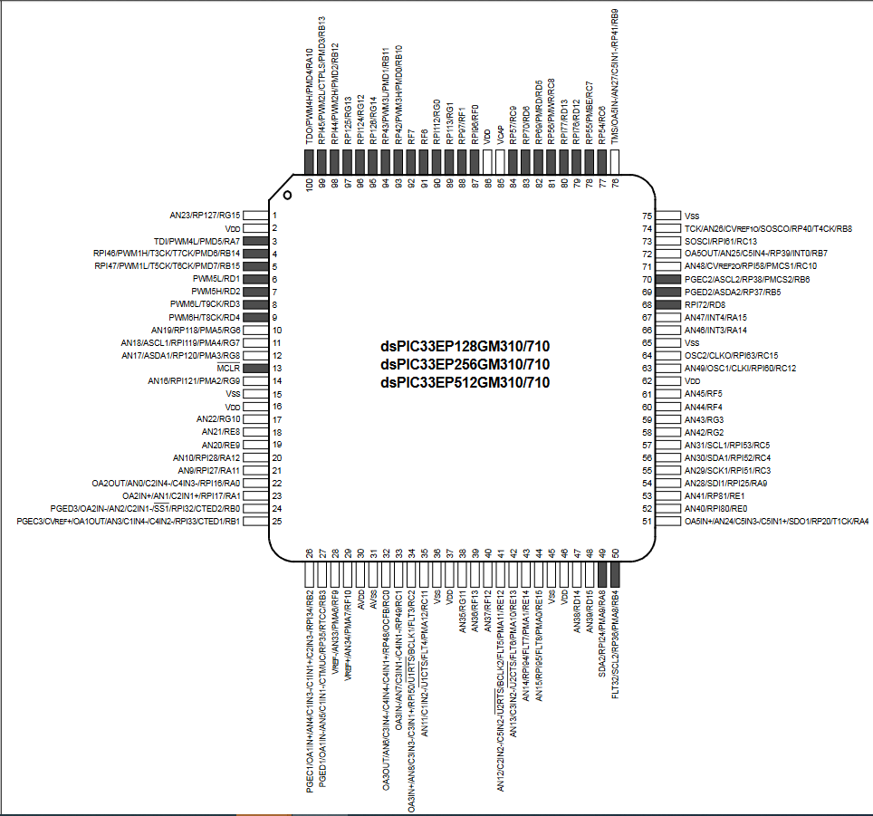
100 pin TQFP
Package
256 KB RAM
3.3 V Supply
Nice, but how do you breadboard this?

Slide 4
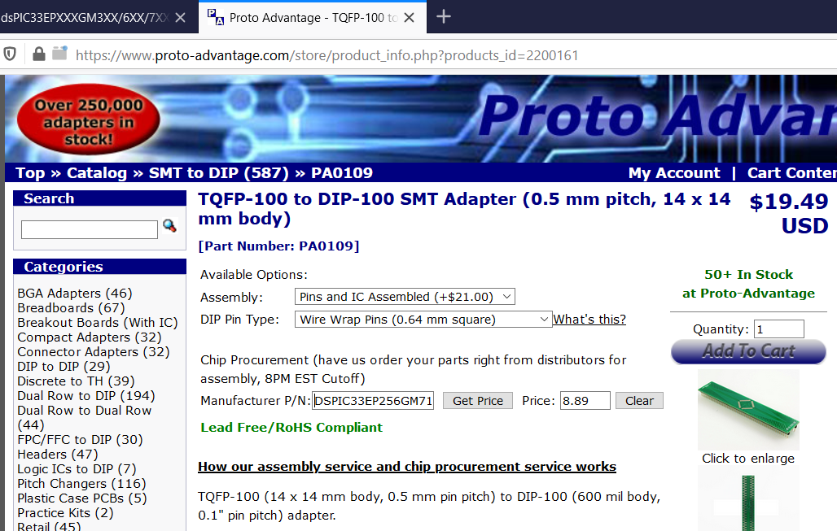
How to breadboard?
Proto-advantage makes a carrier and will solder the IC for you!

Slide 5
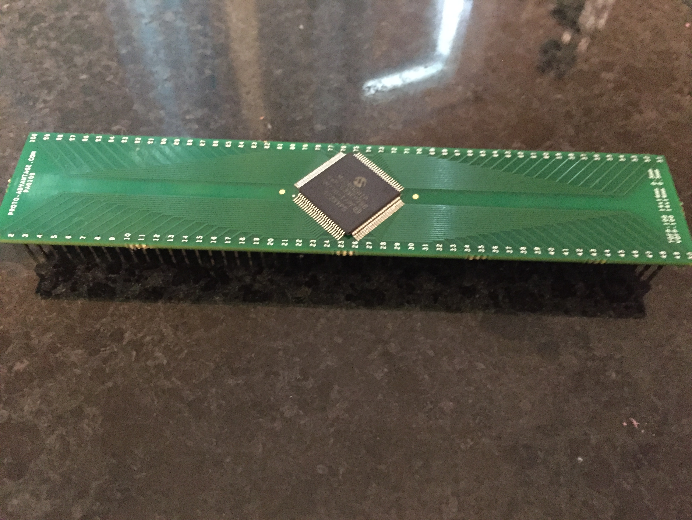
A couple days later, the part shows up!
Nice!

Slide 6
Breadboard connections
VDD (+3.3V)
dsPIC pins 2, 16, 37,46,62,86 to +3.3V bus
VSS (GND)
dsPIC pins 15,36,45,65,75 to GND bus
AVDD dsPIC pin 30 (to +3.3V bus)
AVSS dsPIC pin 31 (to GND bus)
VCAP dsPIC 85 to 10 uF cap other end to GND bus
PICKIT3 CONNECTIONS
1 – MCLR dsPIC PIN 13 (see next Figure)
2 – VDD (+3.3 bus)
3 – VSS (GND bus)
4 – dsPIC PIN PGED 27
5 – dsPIC PGEC 26
Add decoupling caps (0.1 uF) across VCC, VSS

Slide 7
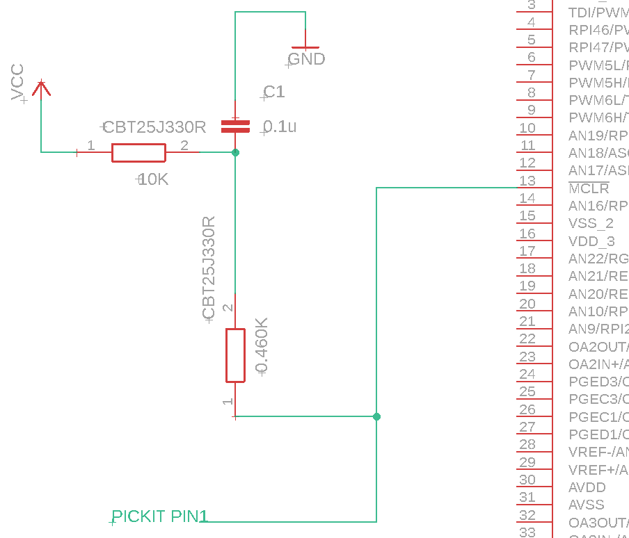
MCLR and PICKIT PIN 1 Connections
2 resistors: 10k, 460 Ohms;
1 capacitor: 0.1 uF

Slide 8
LED Connection PORT E PIN 1

Slide 9
3.3V Power from ADAFruit USB Breakout board and LD1117V33C Linear Regulator

Slide 10
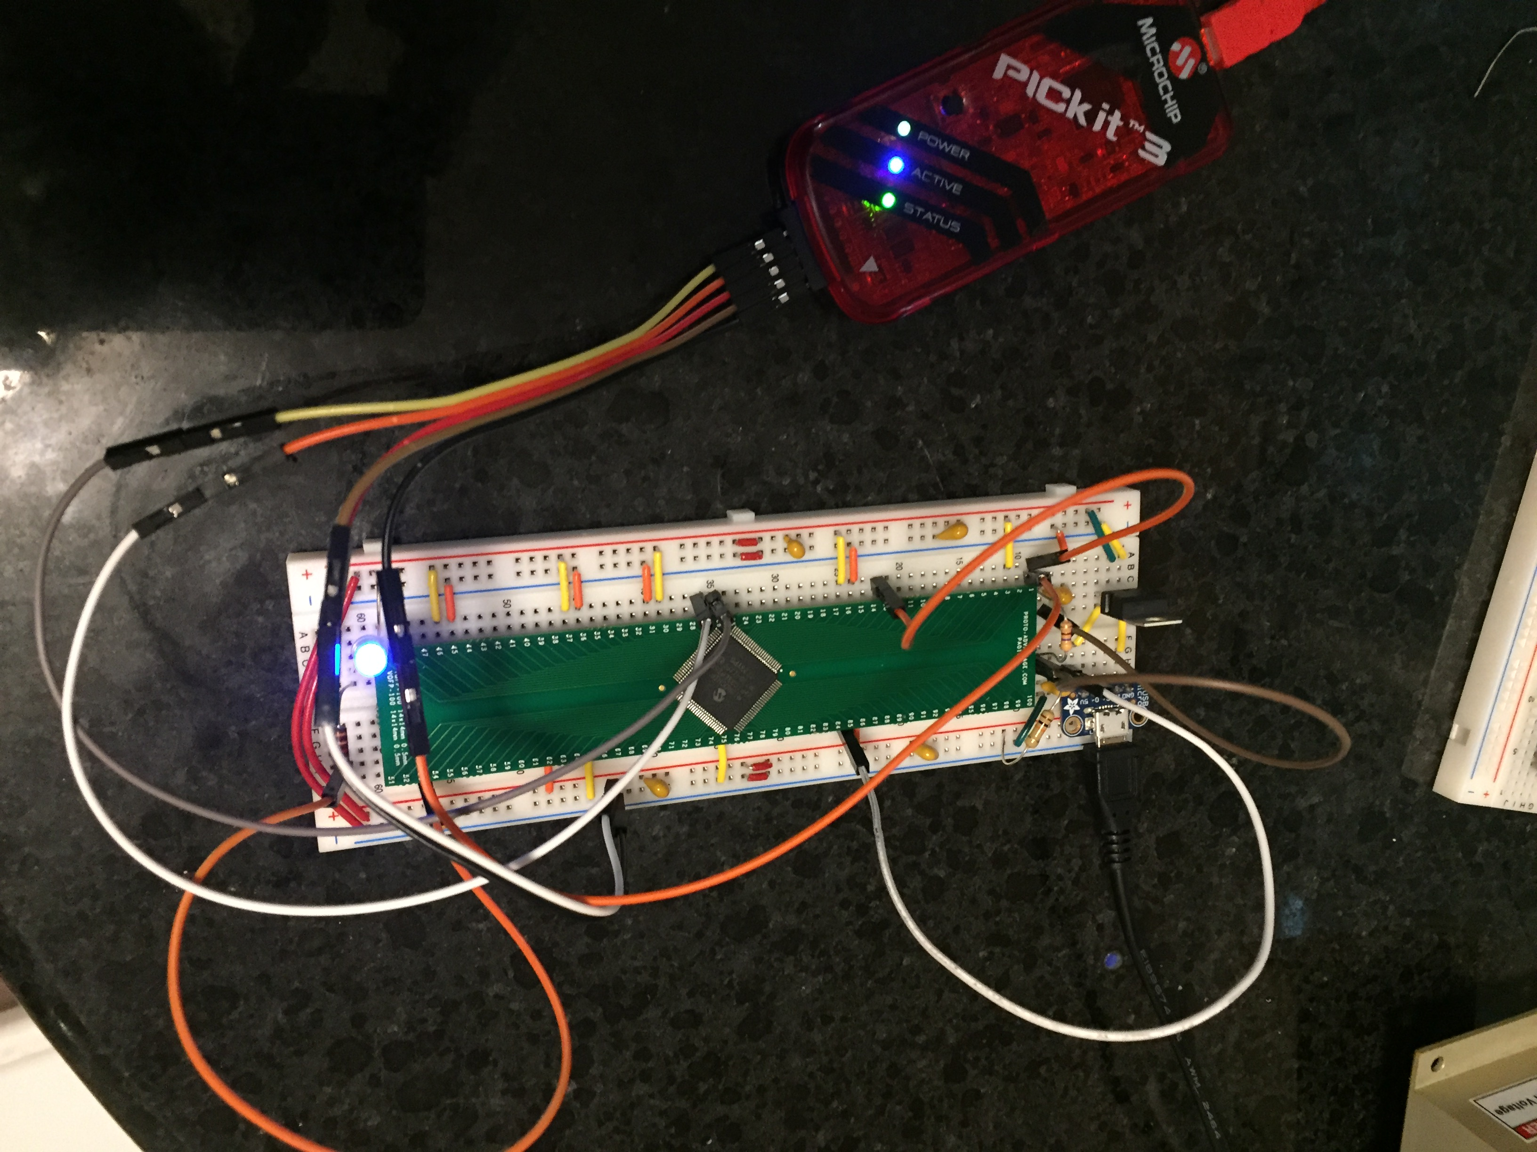
NOW THE CODE IN MPLABX!

