Slide 1
The Spartan 3A FPGA: XC3S50A-4VQG100C
A breadboarding Adventure

Slide 2
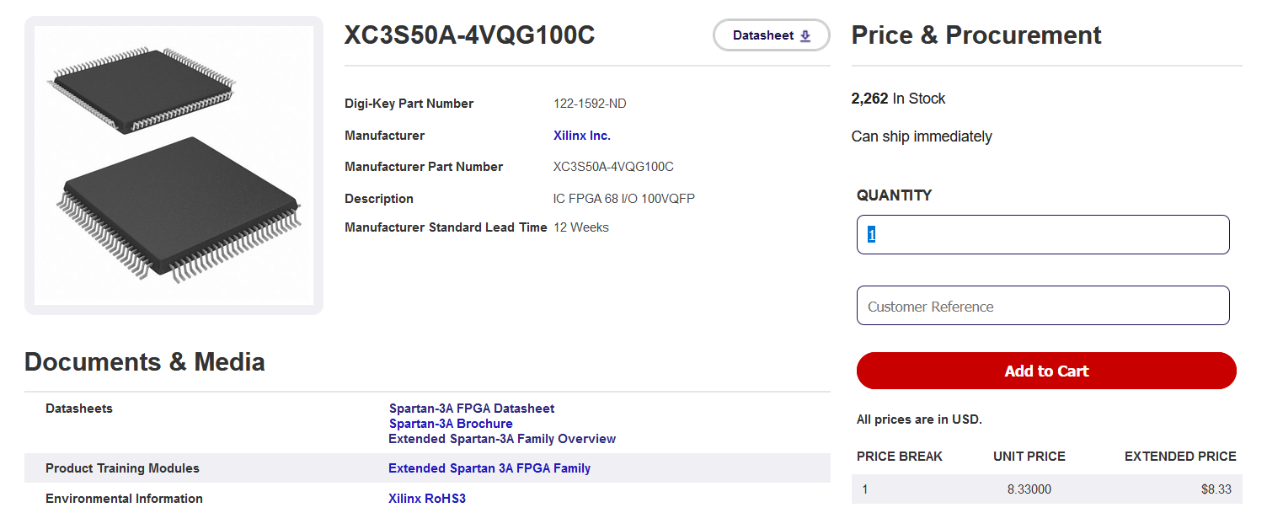
FPGA Test, start with a Spartan 3A chip.
50k gates.
1.2 V internal logic.
100 pin TQFP

Slide 3
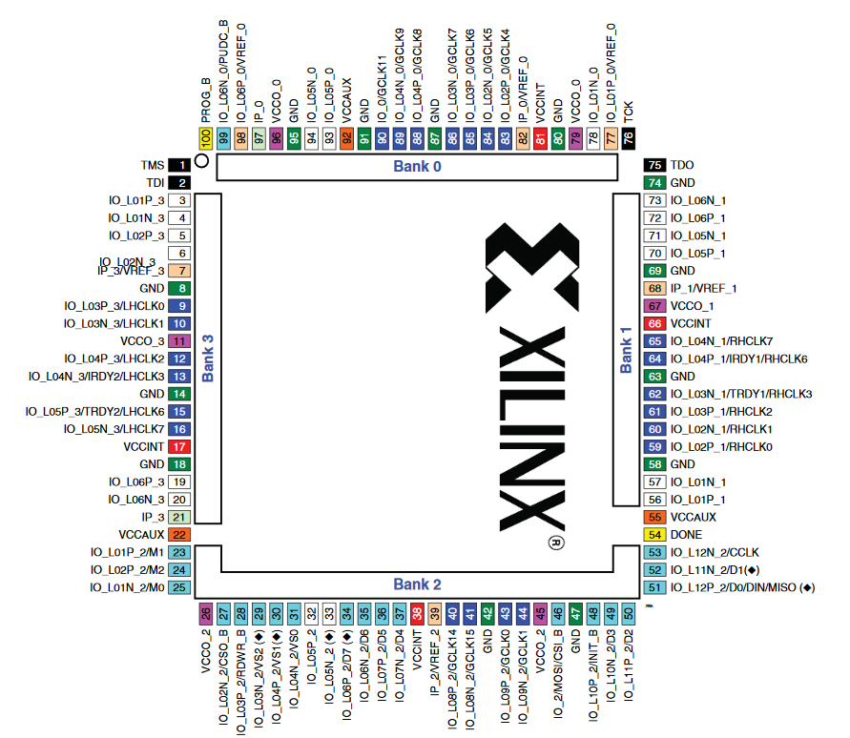

Slide 4
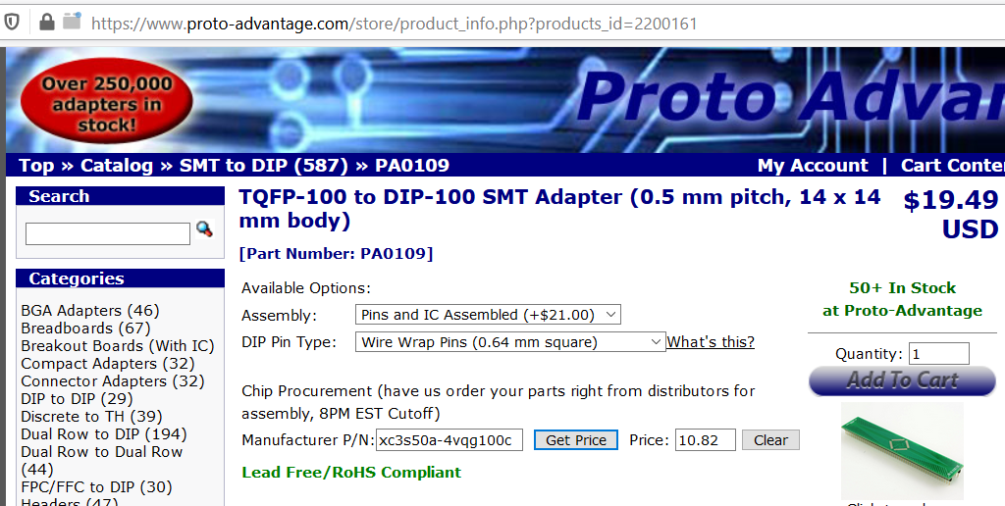
Obtained chip on protoadvantage TQFP to DIP adapter (100 pin).
Pins and IC assembled.

Slide 5
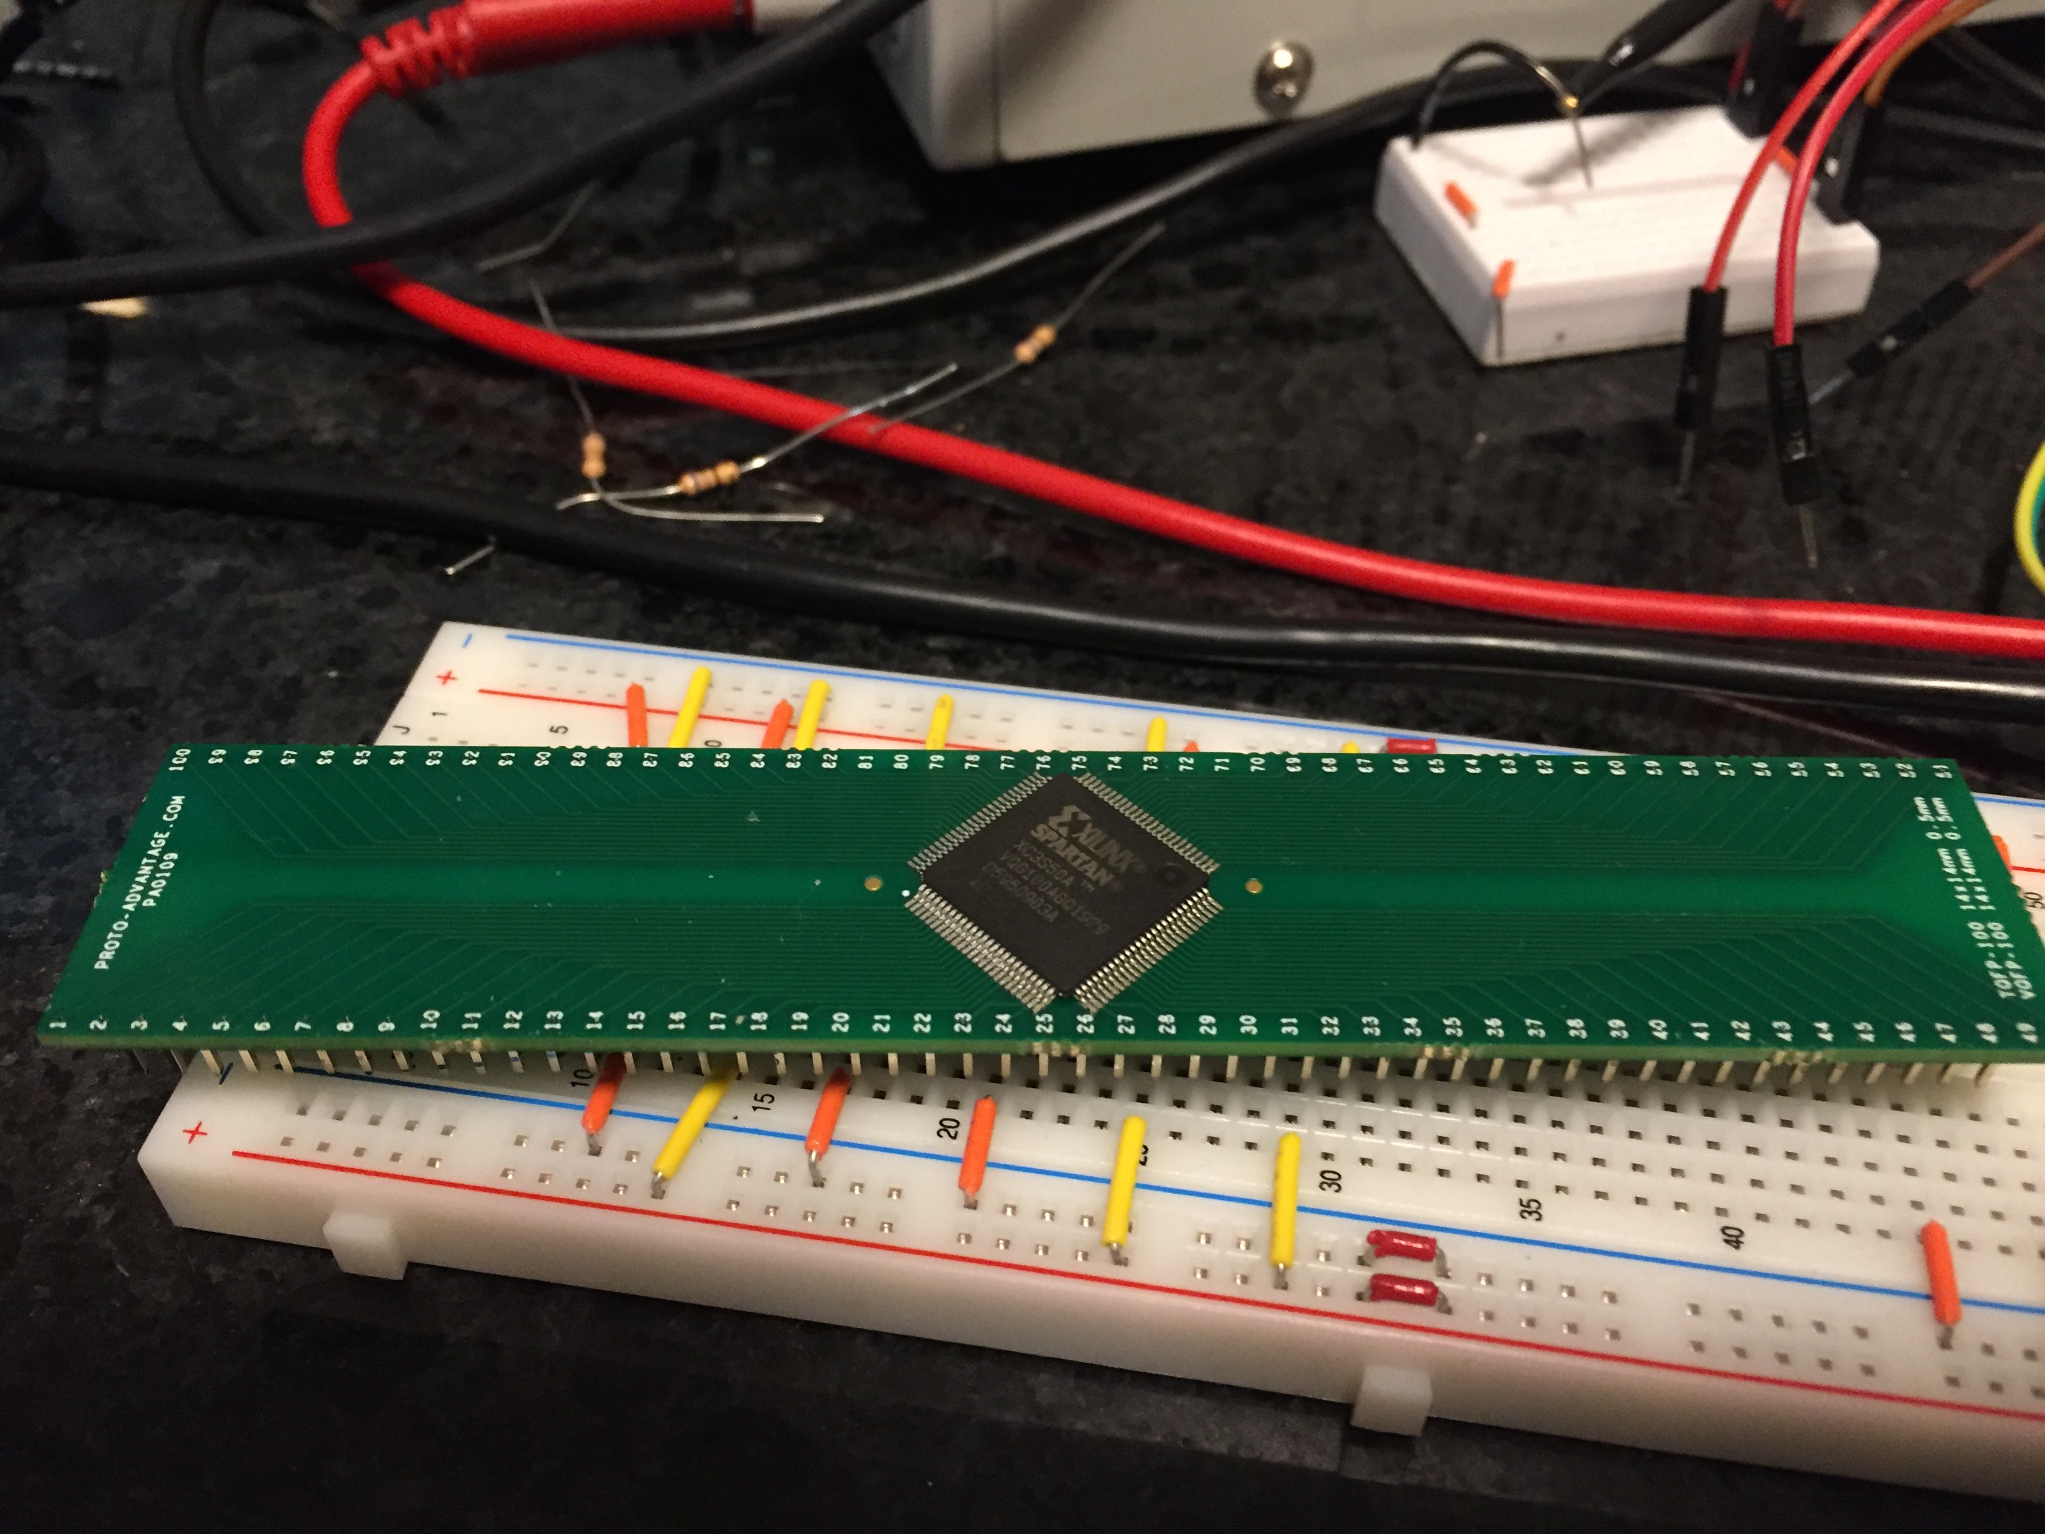

Slide 6
Breadboard connections
VCCO/VCCAUX (+3.3V)
VCCO = 11,26,45,67,79,96 to +3.3V bus
VCCAUX = 22,55,92
Power supply for 1.2V
VCCINT = 17,39,66,81
GND
pins 8,14,18,42,47,58,63,69,74,80,87,91,95 to GND bus
JTAG CONNECTIONS
1 – TMS
2 – TDI
75 – TDO
76 – TCK
Add decoupling caps (0.1 uF) across +3.3,GND

Slide 7
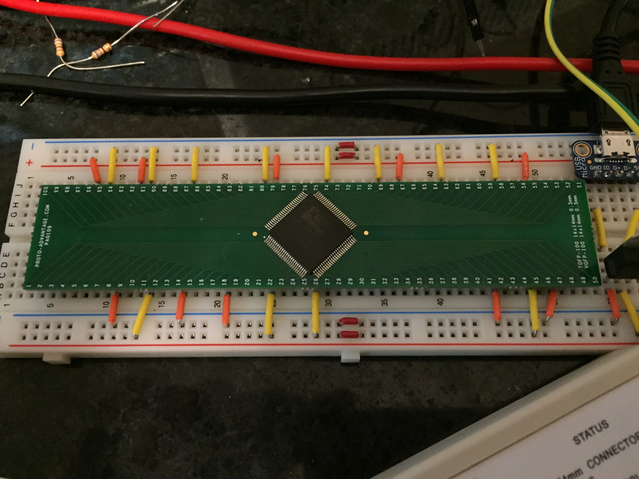
Adafruit 5V microUSB breakout to LM1117C 3.3 V linear regulator
Makes GND Bus
And 3.3V bus
For
VCCO
VCCAUX

Slide 8
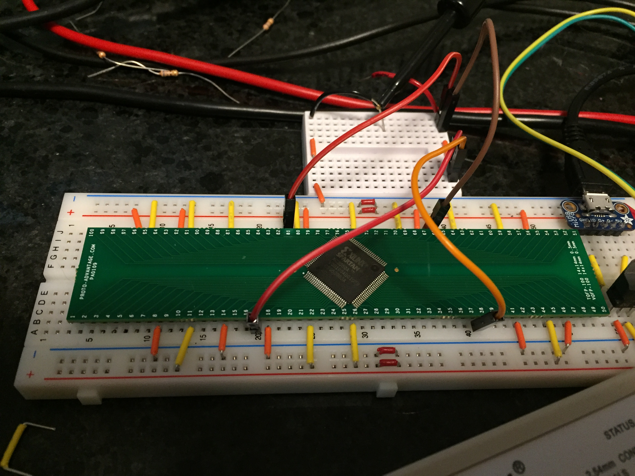
Added 1.2V VCCINT connections Power supply to small breadboard; make sure to link grounds. Used jumpers to VCCINT pins.

Slide 9
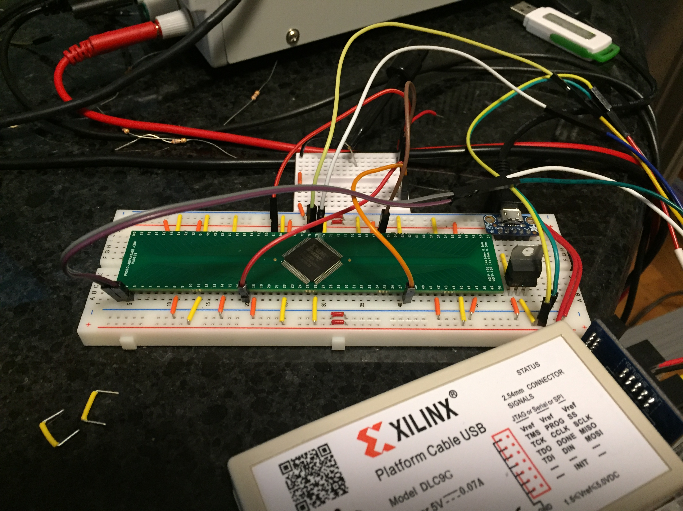
All JTAG connections shown; pins 1,2,75,76 plus VCCAUX and GND.

