Slide 1
Adventures in Motors and Encoders!

Slide 2
Overview
Goal: Check accuracy of motor encoder (HEDL-5605 A06) on POWERMAX II stepper motor
Can we use GRBL to drive the motor, read pulses from the encoder, and detect lost steps/motor stall?
Components:
  C8051F410 (read quadrature decoder counter, send results to 7 seg displays)
  Quadrature decoder (read encoder pulses)
  IO expander chips (interface with 7 seg displays)
  7 seg displays (display results)
  Motor and encoder

Slide 3
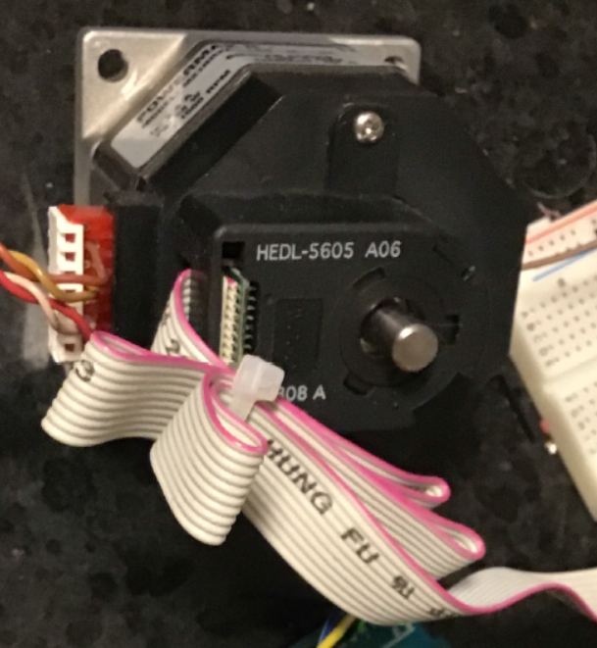
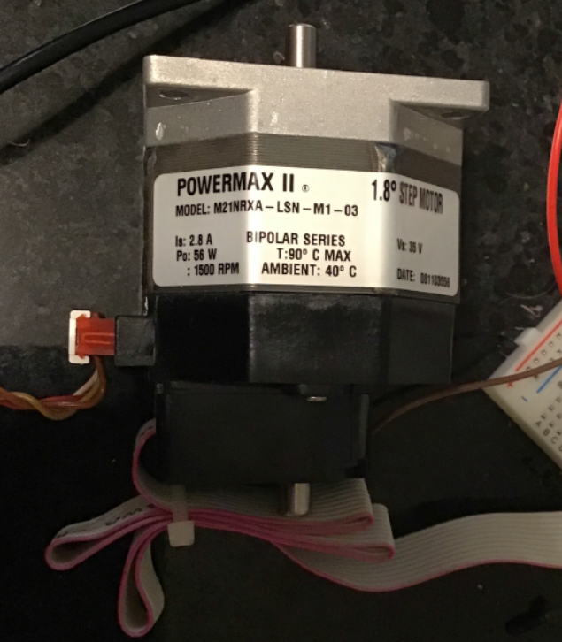
The SETUP: MOTOR
MOTOR
Encoder
PowerMax II
HEDL-5605 A06

Slide 4
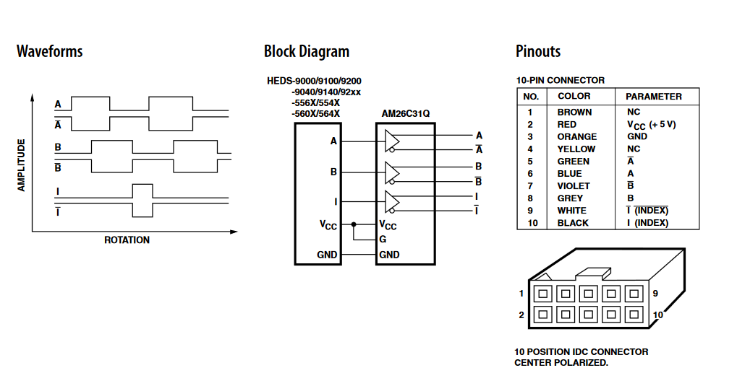
Depending on which way the motor shaft spins, A will lead B, or vice versa.
Encoder
HEDL-5605 A06

Slide 5
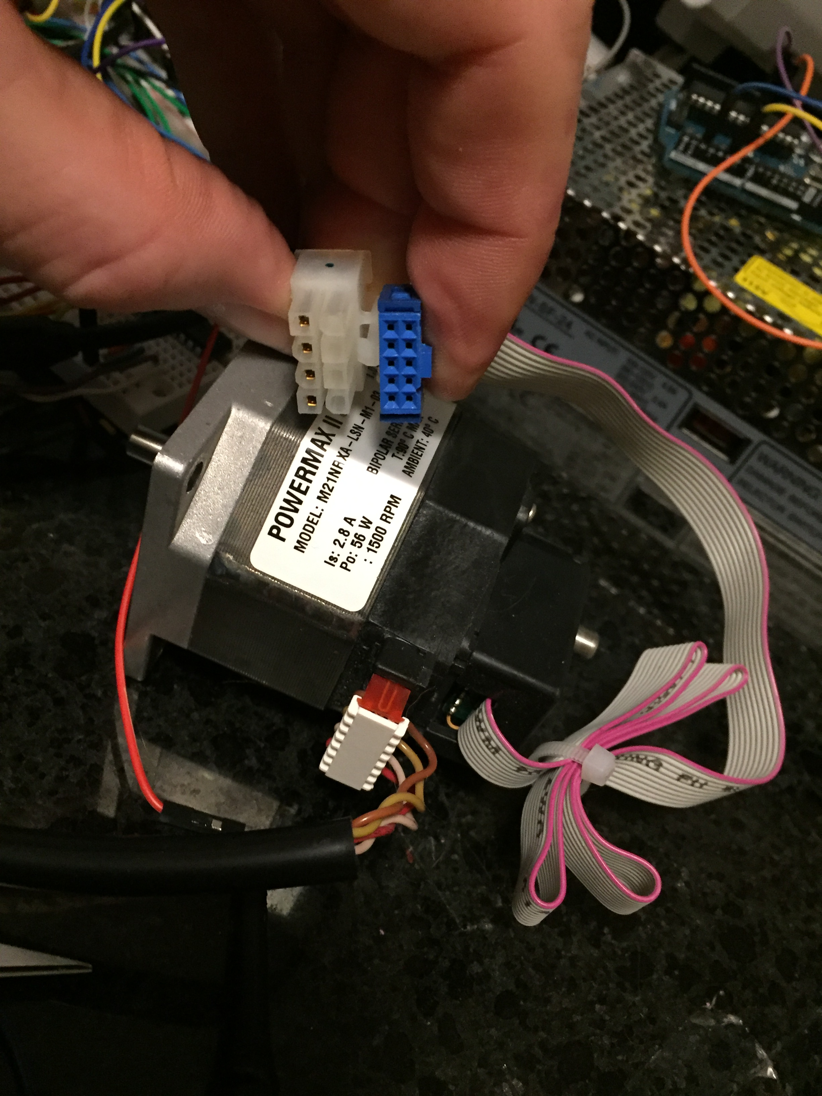
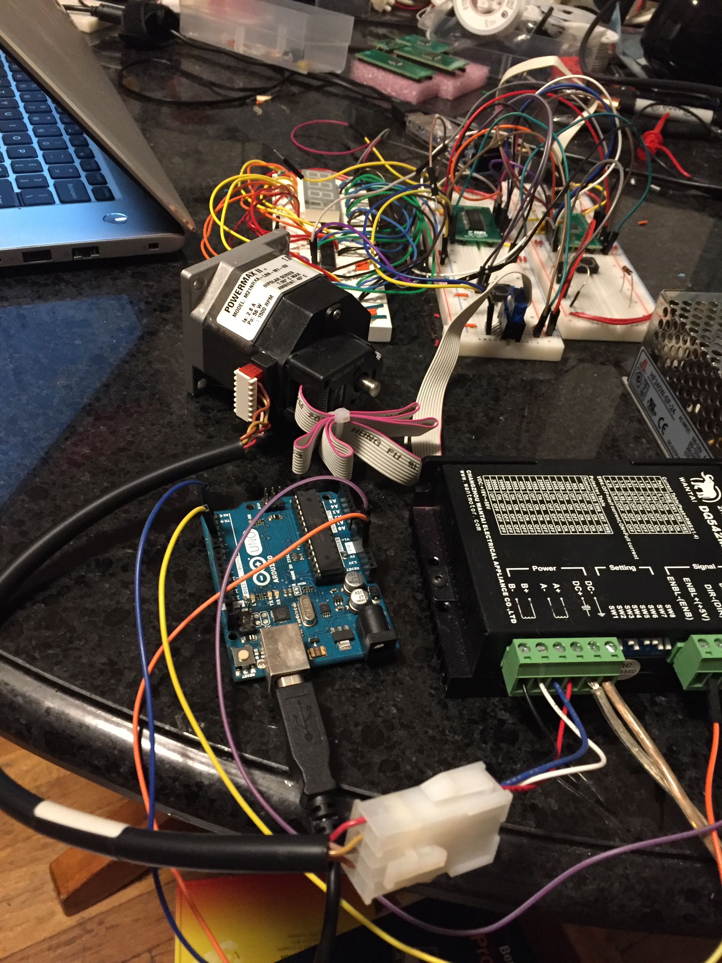
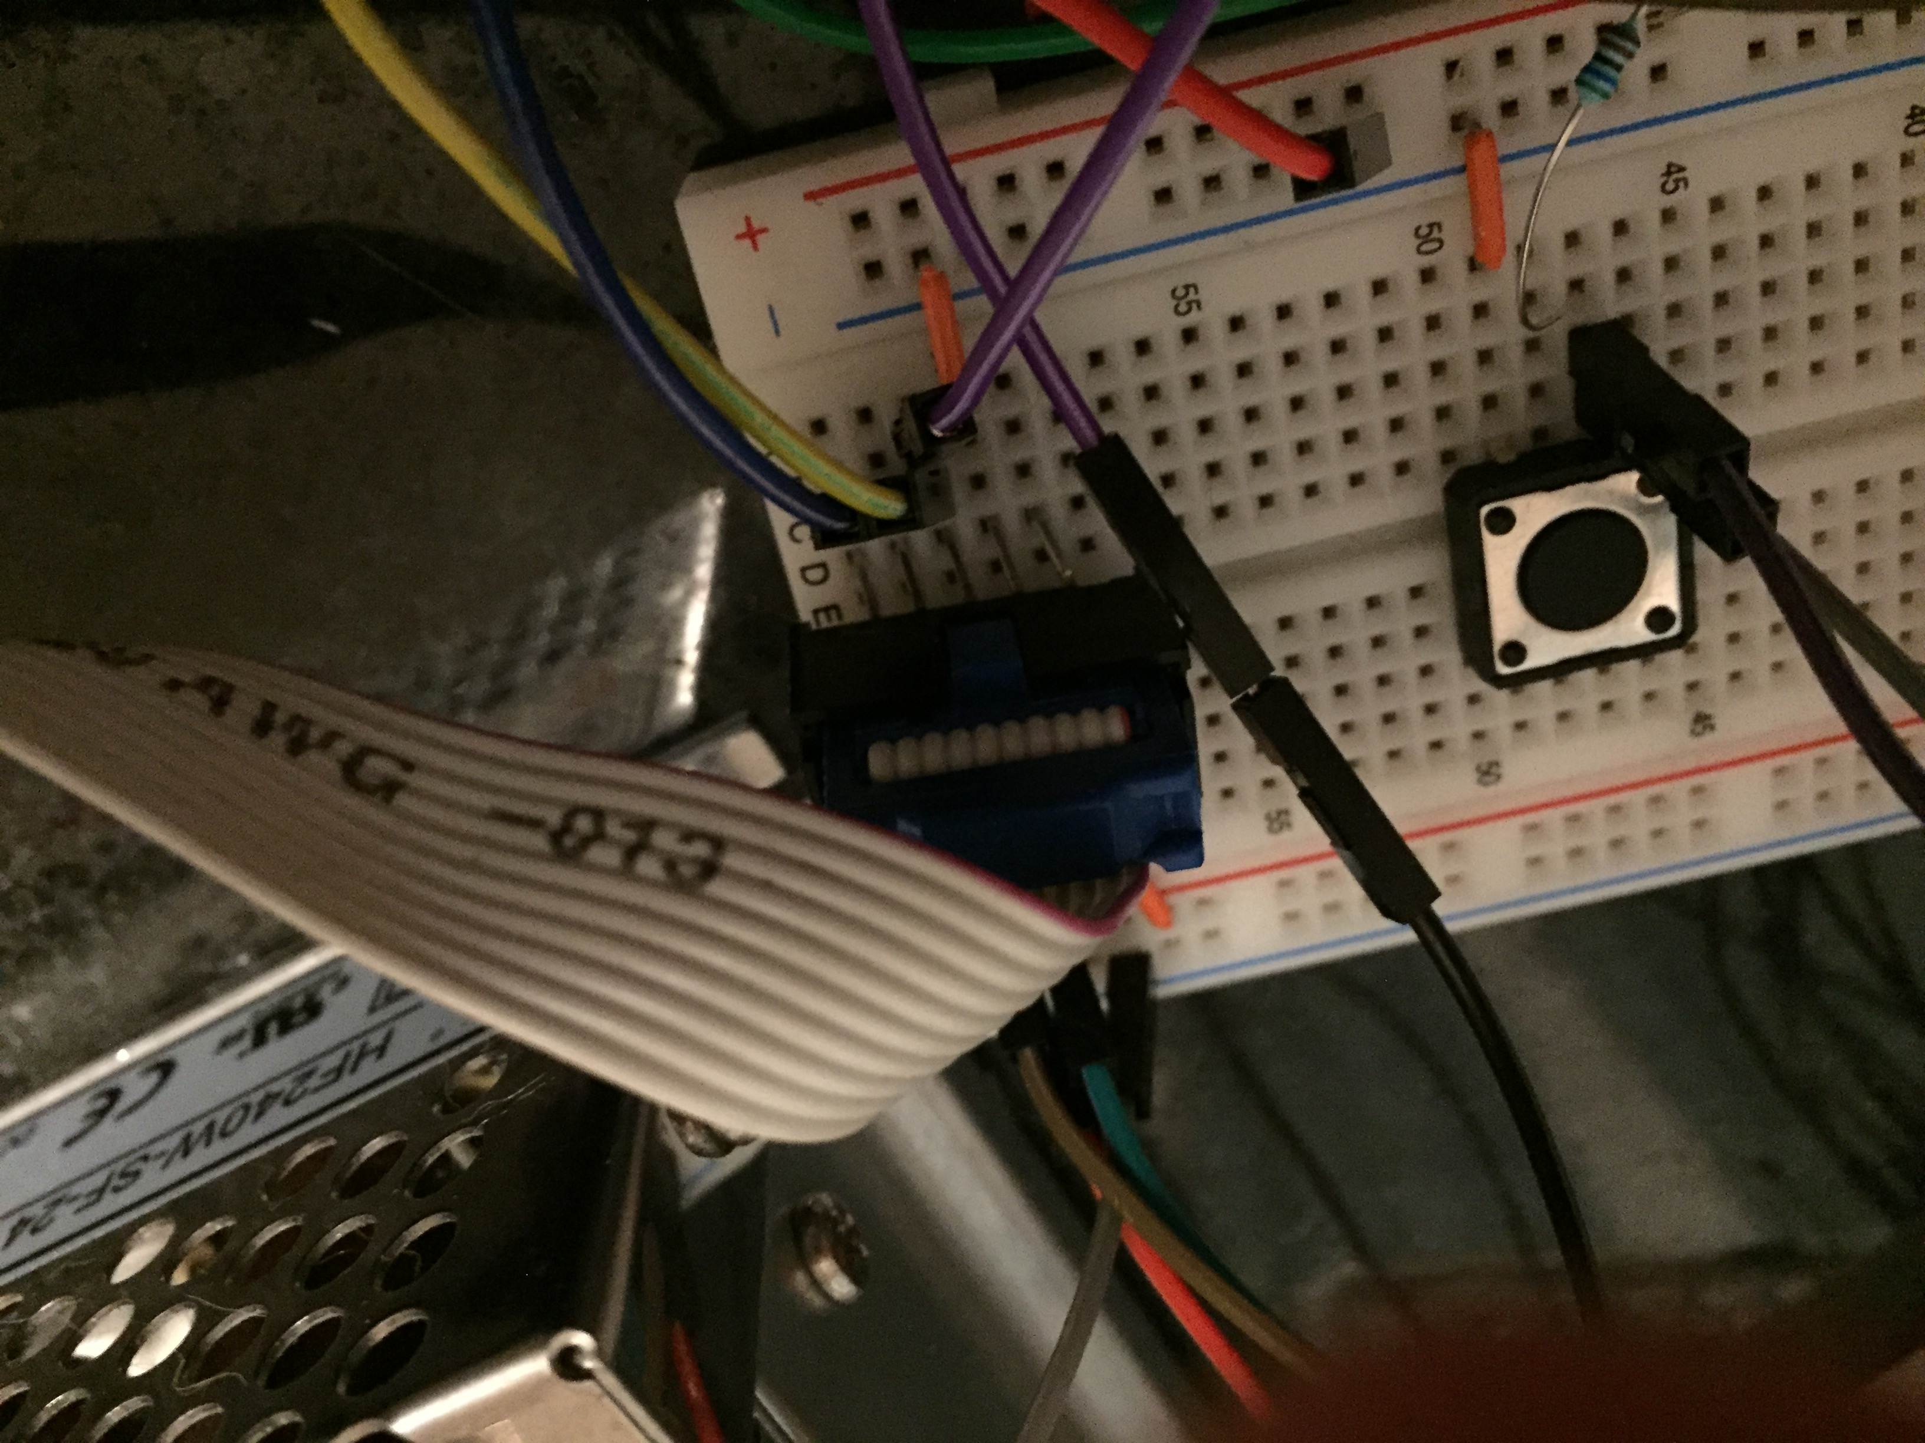
Two connectors
One 2x4 molex
Mini fit jr → motor coils
The other
Smaller 2x5
IDC Connector
→ motor encoder
Motor coil pins
Encoder pins
10 pin IDC connector (2x5) goes to A33179 header; pins bent to straddle breadboard trench as in LAoE pg 794.
Made mating Molex Mini Fit Jr. connector to Stepper motor driver motor coil connector
https://learningtheartofelectronics.com/
The SETUP: MOTOR Connections

Slide 6
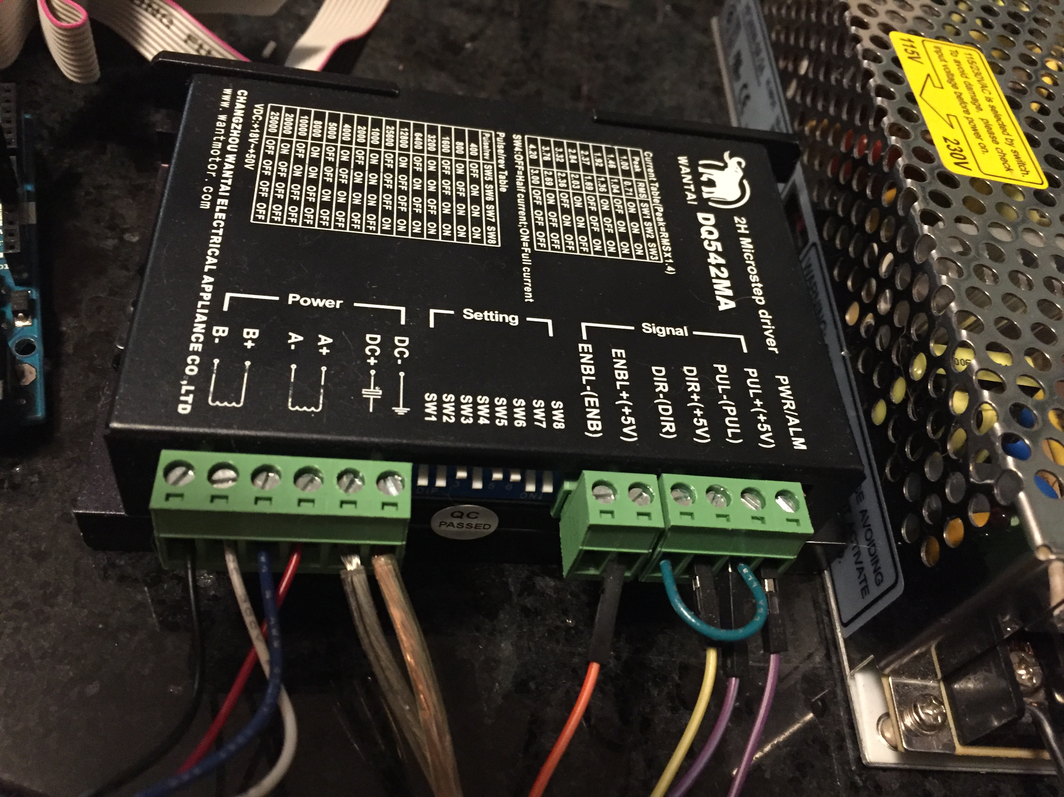
DQ542MA Stepper motor driver.
Purchased from OpenBuilds.
Connections –
A+/A-
B+/B-
DC+ power supply +
DC- power supply -
ENBL+ +5V (Arduino pin)
ENBL- Not connected
DIR+/- +Direction, Arduino pin 5
- Arduino GND
PUL+/- +Pulse, Arduino pin 2
- Ardunio GND (tie to DIR -)
Motor coil connectors
!! Care must be taken working with power supplies !! Take proper precautions !!
The SETUP: MOTOR DRIVER

Slide 7
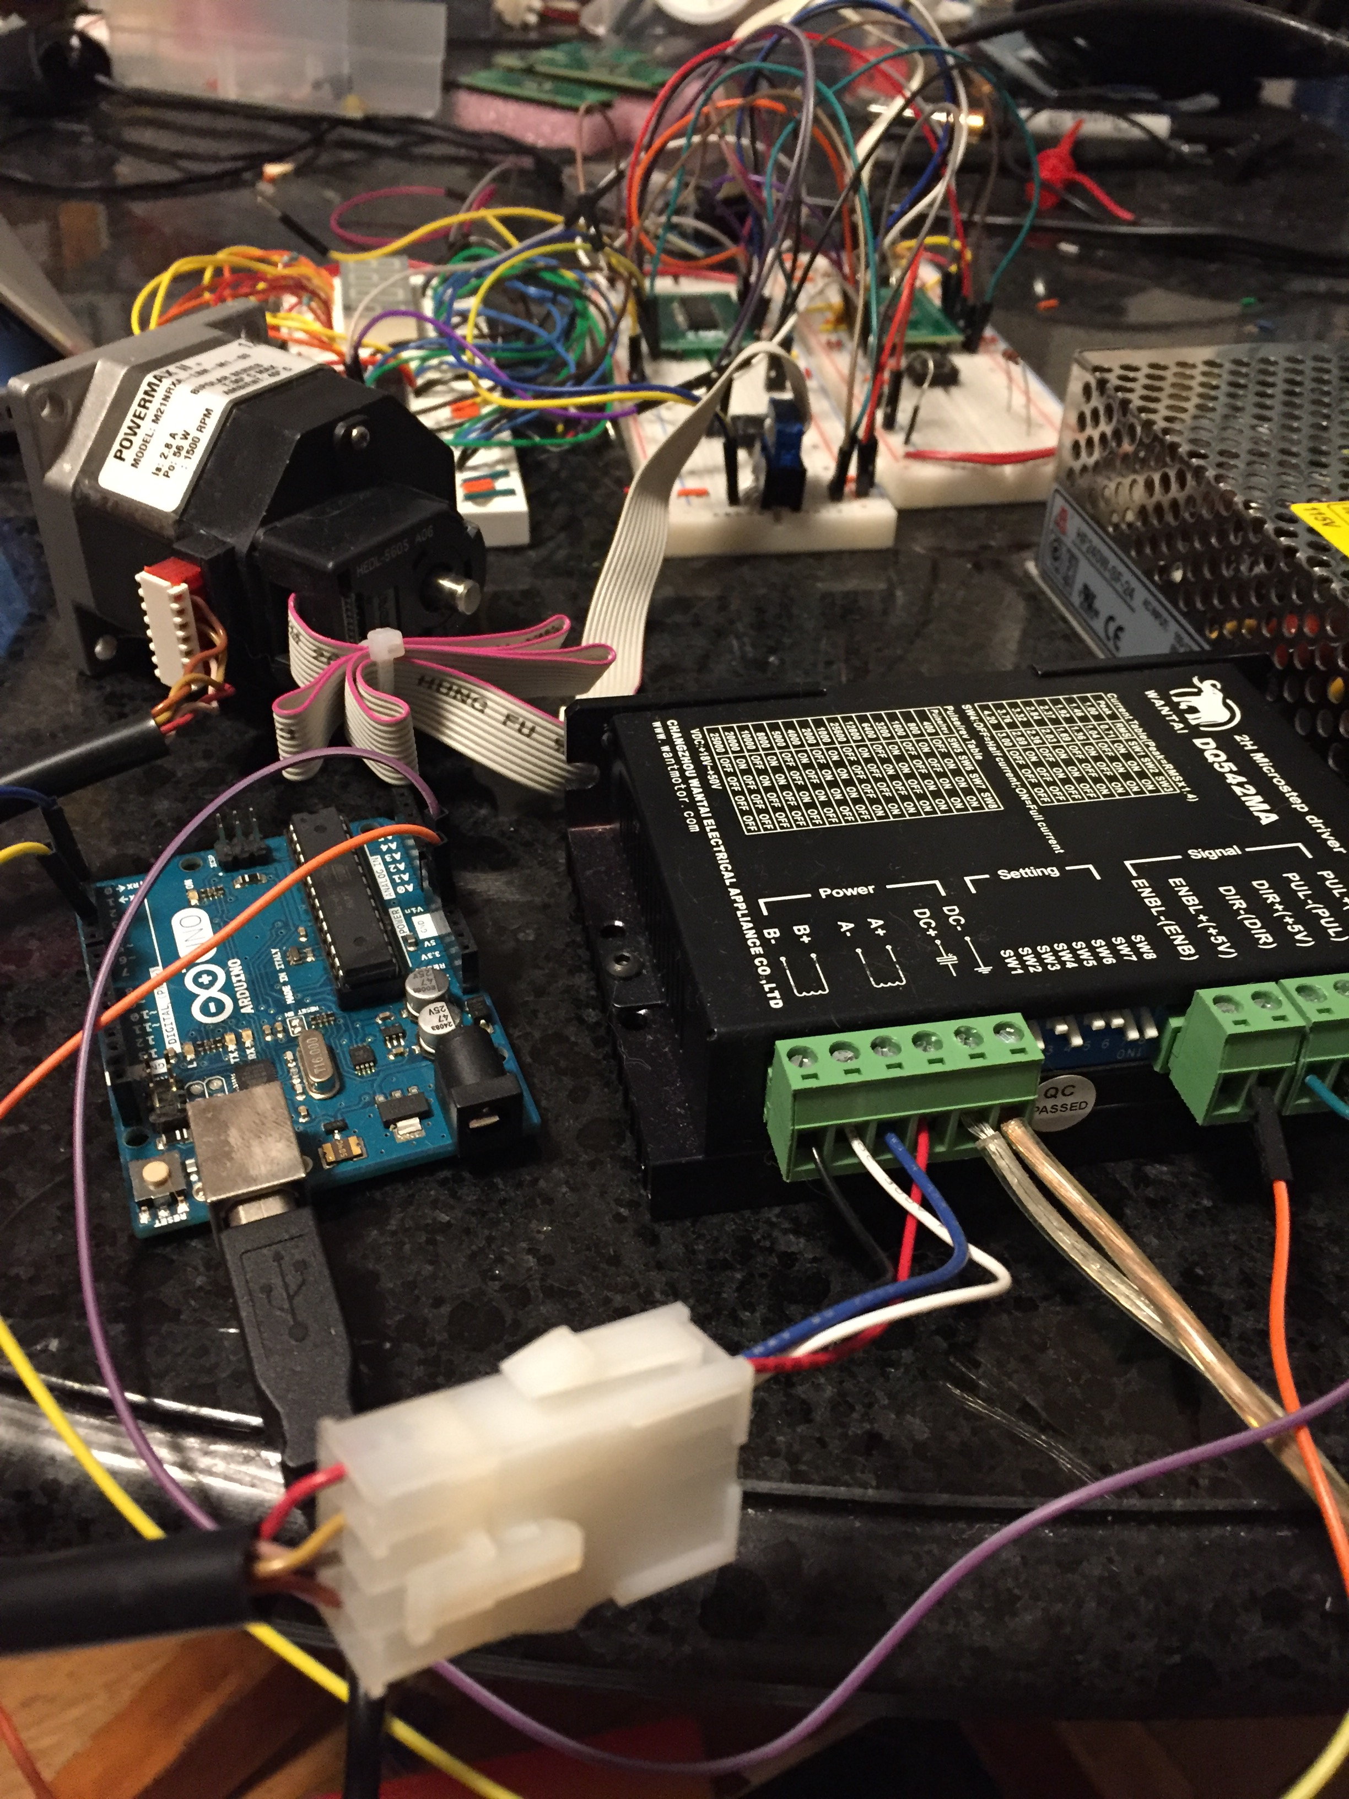
The SETUP: MOTOR DRIVER: Closeup coil pin connections
The motor driver applies current to the coils to move the motor, as well as hold it in position.
MOLEX
#39-01-2081 8 CKT PLUG HOUSING (connect to driver)
#39-01-2080 8 CKT RCPT HOUSING (motor wires)
Making these connectors is another tutorial altogether, seriously!

Slide 8
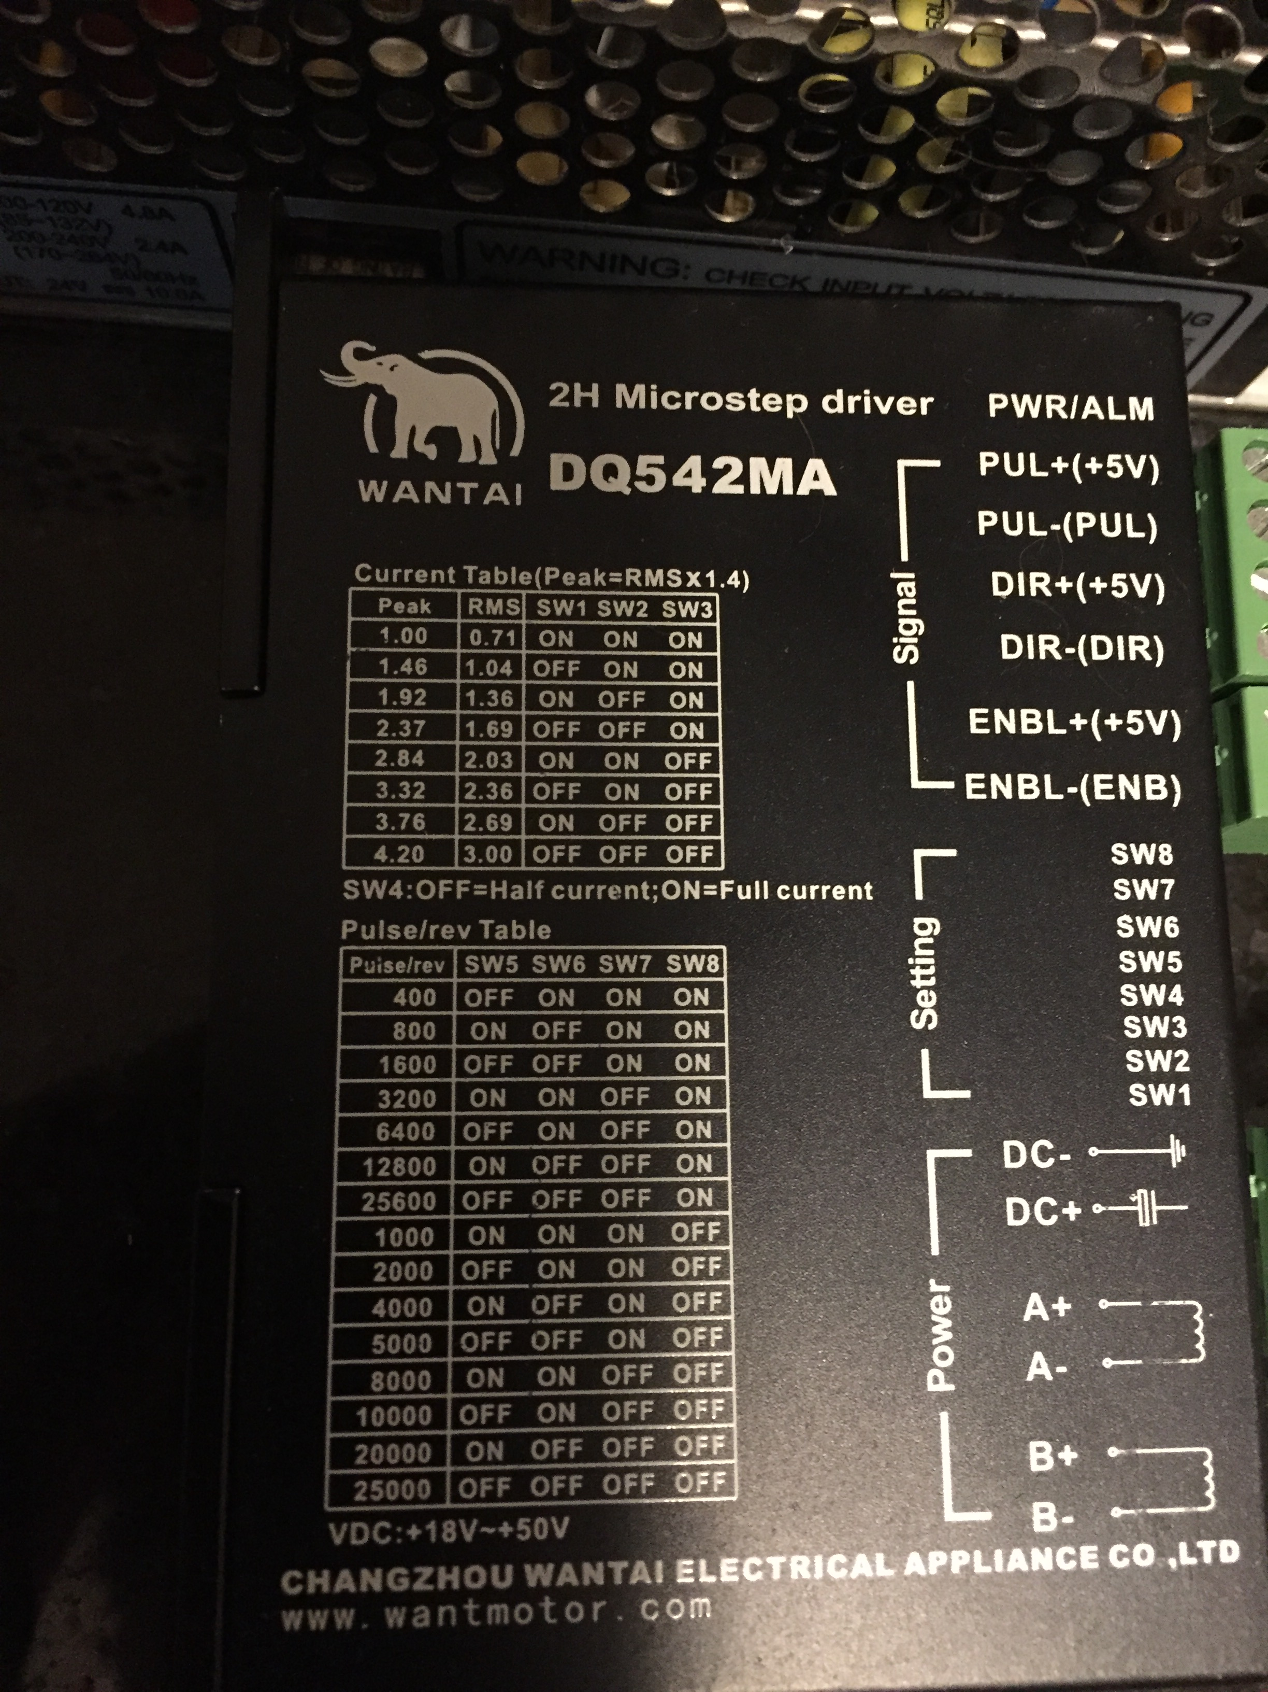
The SETUP: MOTOR DRIVER: DIP switches
Select peak currect and Pulses/rev (microstepping)
SW=4 hold current (ON = full current)
SW1-3 = ON/ON/OFF = 2.84A peak current of motor closest to powermax II (2.8A)
SW5-8 = OFF/ON/ON/ON, 400 pulses/rev for highest accuracy

Slide 9
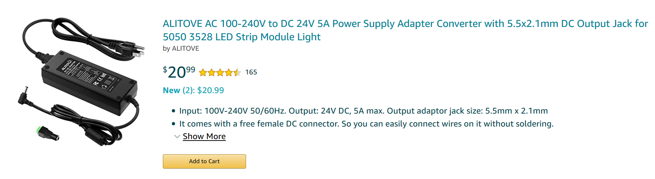
The SETUP: (MOTOR) POWER SUPPLY
This supply is a safer alternative to the one I used.
The barrel jack fits into the adapter which breaks out +/- which would go to the motor driver DC+ and DC- terminals.
This is safer in the sense that you aren’t working on terminals meant for 120VAC (instead direct plug to wall), BUT it can still put out 5 Amps of DC @ 24V, so treat it with respect and use carefully.

Slide 10
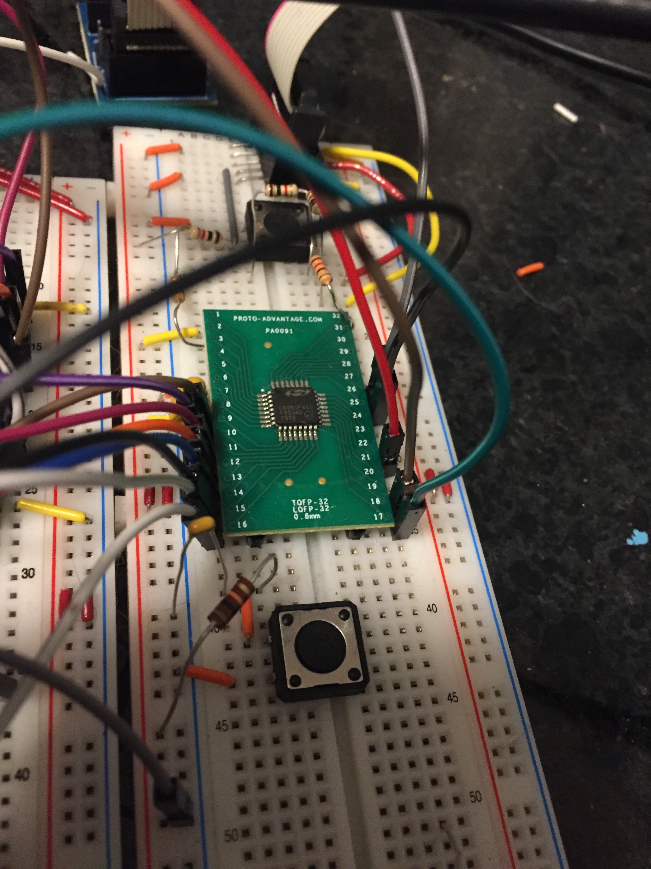
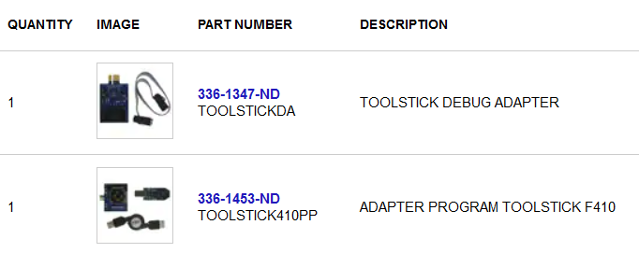
The SETUP: ‘8051
Trusty 8051!
Wired up as described in LAoE 20L.3 SiLabs 1: startup pg 792-802.
C8051F10 on PA0091 (ProtoAdvantage)
https://learningtheartofelectronics.com/
PORT 1 pins 0-7 hookup to Quadrature encoder D0-7.
P0.0 Quadrature decoder SEL1
P0.1 Quadrature decoder SEL2
P0.2 X*/Y
P0.4 Quadrature decoder OE
P2.0 I2C bus SCL (IO expander for display)
P2.1 I2C but SDA (IO expander for display)

Slide 11
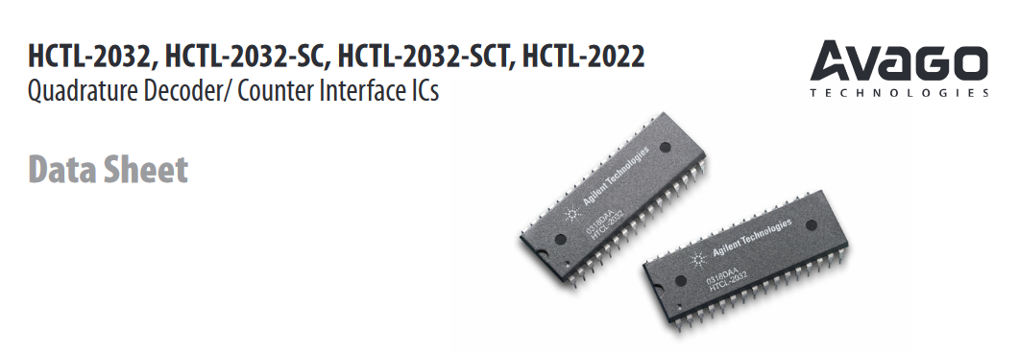
The Quadrature decoder.

Slide 12
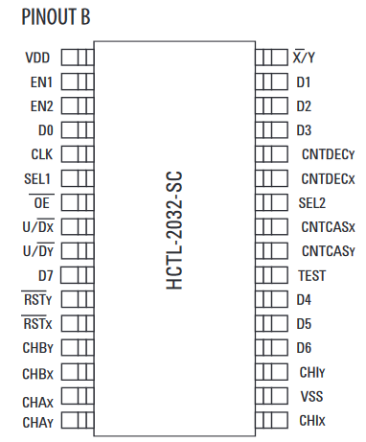
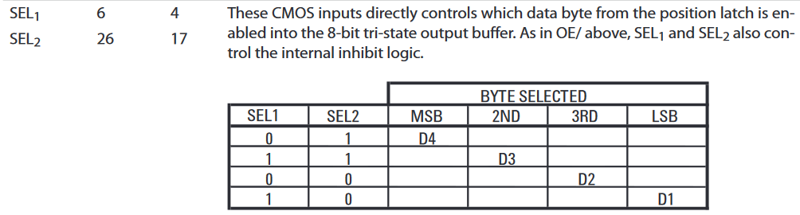
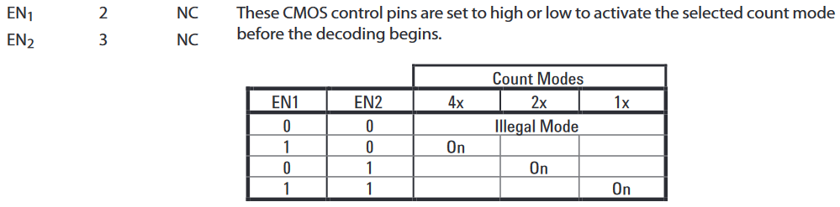
VDD +5V
VSS GND
The SETUP:
Quad Decoder
Wiring
D0-D7 = P1 on ‘8051.
Clk
OE = output enable, P0.4 ‘8051
CHA (x) = B
CHB (x) = A*
CHA (y) = A
CHB (y) = B*
Quad decoder channel signals from motor encoder
B*
A*
B
A
RSTX, RSTY → Switch (next pg)
X*/Y = P0.2
EN1, EN2 = +5V
SEL1 = P0.0, SEL2 = P0.1 on ‘8051

Slide 13
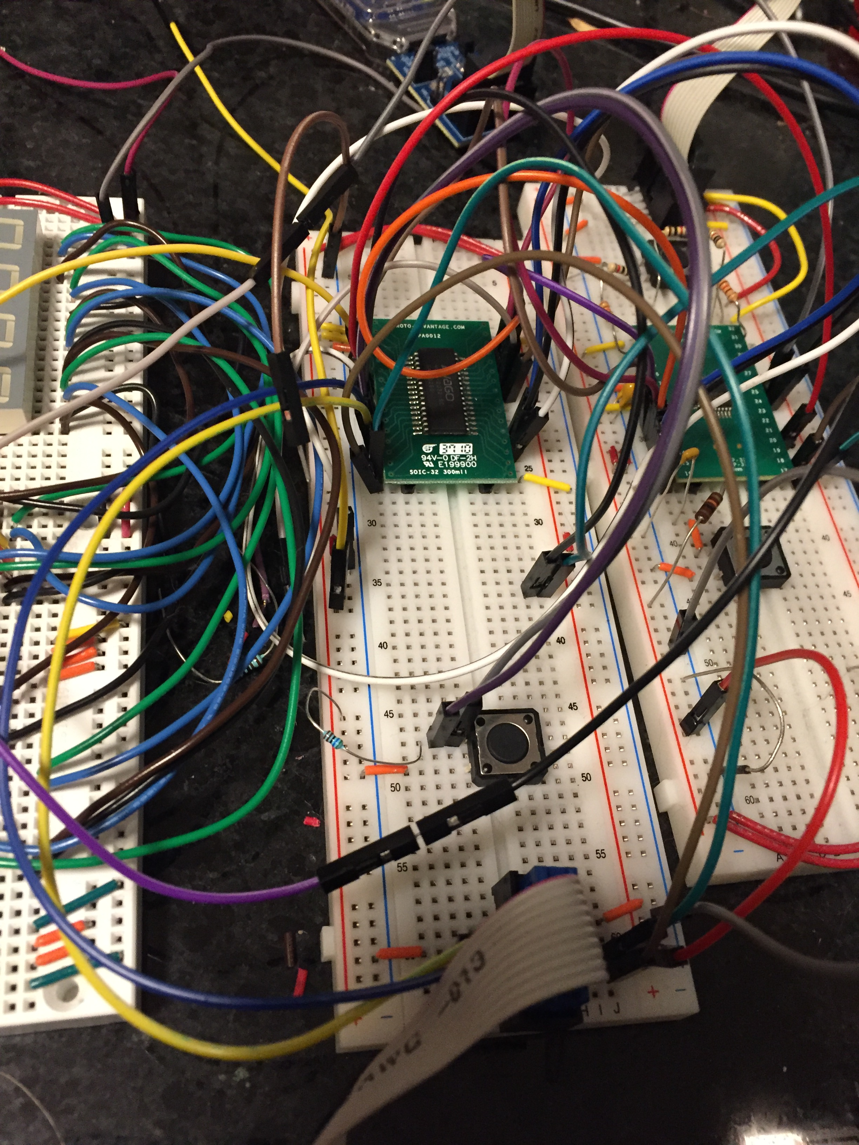
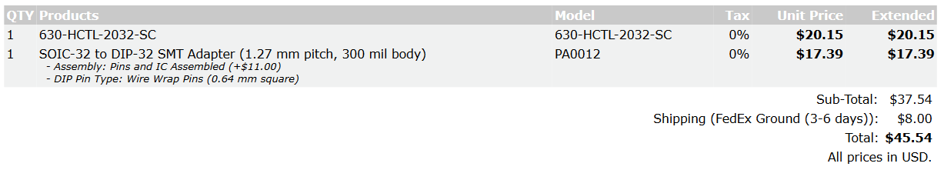
The SETUP:
Quad Decoder
THIS IS A 630-HCTL-2032-SC – NO DIP so protoadvantage put on a PA0012 carrier (proto advantage)
ENCODER
RESET
Reset X*
Reset Y*
GND
+5V

Slide 14
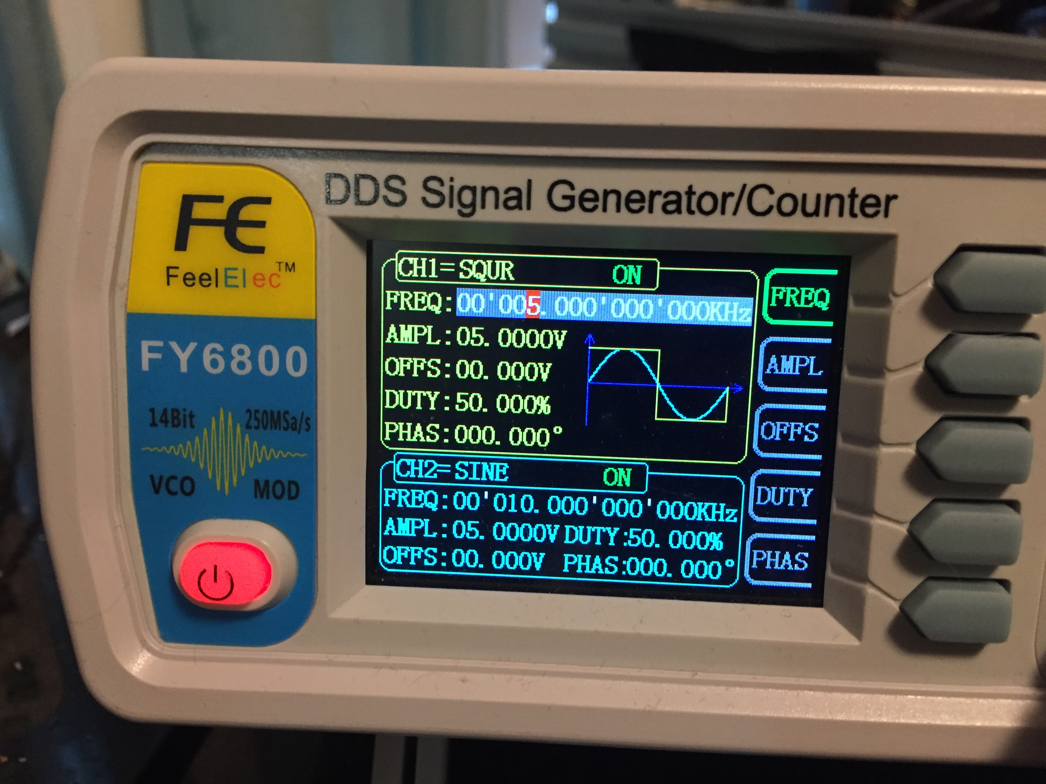
Clock 5 KHz with function generator

Slide 15
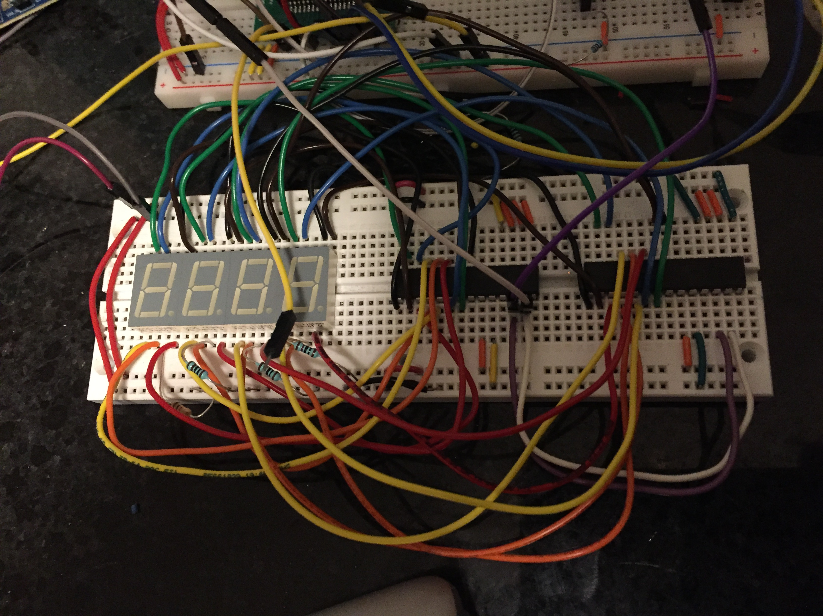
For more details on the IO expander
See previous post:
https://scienceelectronicsfun.com/expand-your-mind-and-i-o-ports-mcp23017/
2 pins come from ‘8051 (SCL and SDA). Remaining pins are power, GND, and IO pins connecting to 4 separate 7 seg displays.
These allow 16 bits of decoder counter to display after counting quadrature pulses from motor encoder.
Display digit 1 = Address 000, port A
Display digit 2 = Address 000, port B
Display digit 3 = Address 001, port A
Display digit 4 = Address 001, port B
000
001
I2C bus from ‘8051
I2C bus 2nd chip
The SETUP: Dual IO expander chips for 4x 7 seg displays

Slide 16
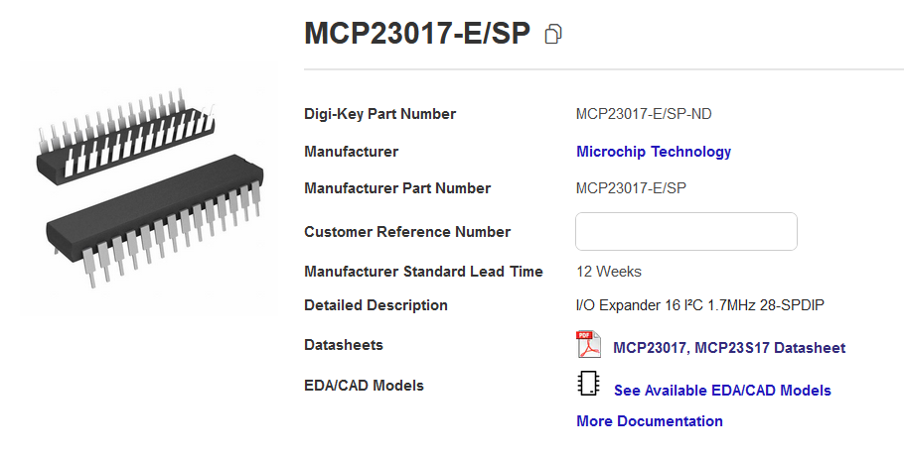
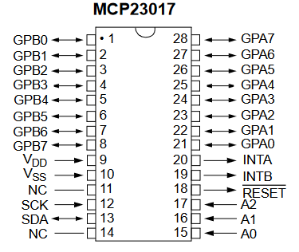
The MCP23017 gives you 2 extra 8 bit ports – useful for pin hungry devices like 7 seg displays and LCDs –
MCP23017 = configured using I2C
MCP23S17 = configured using SPI
For more details on the IO expander
See previous post:
https://scienceelectronicsfun.com/expand-your-mind-and-i-o-ports-mcp23017/

Slide 17
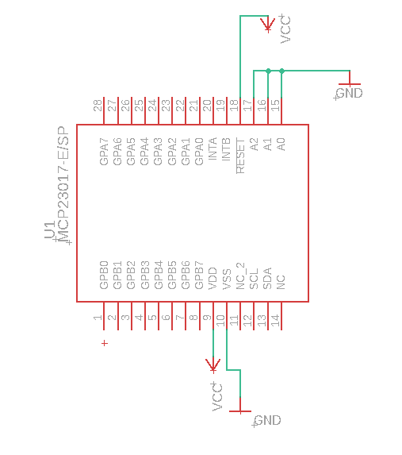
Interrupt
Reset* Active Low
A0, A1, A2 set address, here ‘000’
Allows up to 8 unique chips on one bus! That’s 16 8-bit ports!
PORT A
Simple operation
A0, A1, A2 GND = Address 0
Reset = 5V
VSS = GND
VDD = 5V
I2C pins connect to your microcontroller
PORT B
I2C pins
For more details on the IO expander
See previous post:
https://scienceelectronicsfun.com/expand-your-mind-and-i-o-ports-mcp23017/

Slide 18
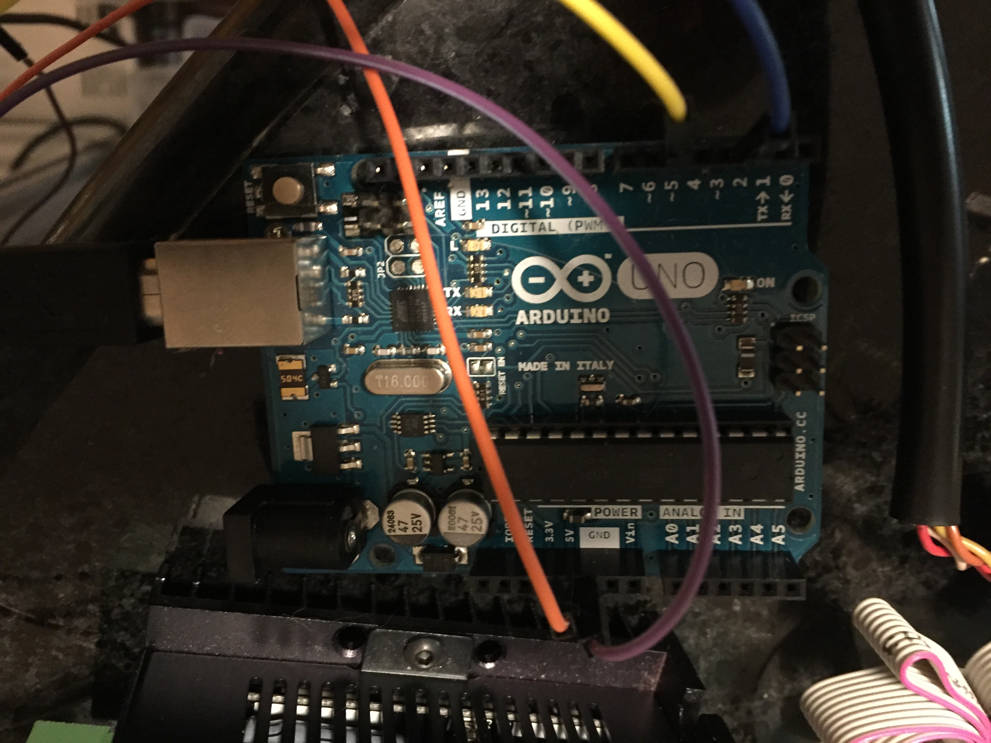
Arduino is loaded with GRBL2Arduino.
https://blog.protoneer.co.nz/grbl-arduino-library/
Arduino pins connect to MOTOR DRIVER (DQ542MA)
ENBL+ +5V (Arduino pin)
ENBL- Not connected
DIR+/- +Direction, Arduino pin 5
- Arduino GND
PUL+/- +Pulse, Arduino pin 2
- Ardunio GND (tie to DIR -)
Open Serial monitor in Arduino IDE to send GRBL commands to move motor.
The SETUP: Arduino for motor control

Slide 19
The whole setup!
Overly complicated project to evaluate motor encoder accuracy? Probably.
Fun? Definitely.

Slide 20
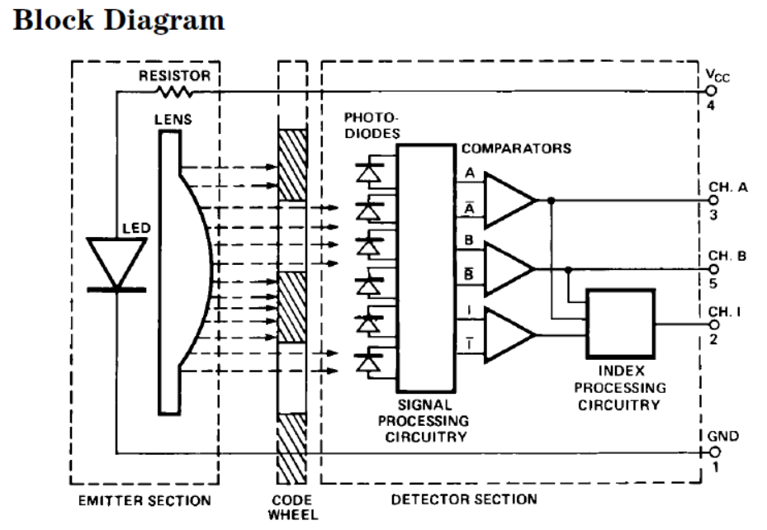
MOTOR ENCODER: BACKGROUND
Apparently, these work by using a codewheel that spins, changing how an LED transmits light to a small photodiode array.
Let’s try it out!!

Slide 21
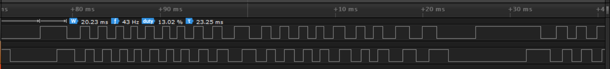
A first test
Provide power and ground to the encoder, and interface A and B signals to the Saleae logic analyzer, then spin the shaft by hand.
A
B
Pulses are sent out by the encoder! Cool!

Slide 22
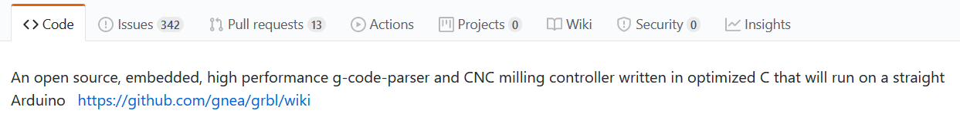
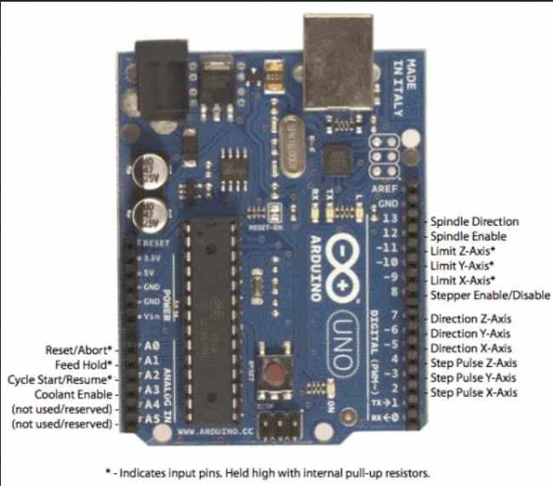
What is GRBL?
https://github.com/grbl/grbl
GRBL will take G-code, and send appropriate pulses to your stepper motor drivers. It also will take care of homing.
Commands:
$X unlock (without homing)
$H run homing cycle
G0 (go absolute)
G0 X2.5 Y5 Z8 (go absolute to coordinates x 2.5, y 5, z 8)
You can run commands over serial from Arduino or a G-code sender program
$$ (view Grbl settings)
$# (view # parameters)
$G (view parser state)
$N (view startup blocks)
$x=value (save Grbl setting)
$Nx=line (save startup block)
$C (check gcode mode)
$X (kill alarm lock)
$H (run homing cycle)
~ (cycle start)
! (feed hold)
? (current status)
ctrl-x (reset Grbl)
ok

Slide 23
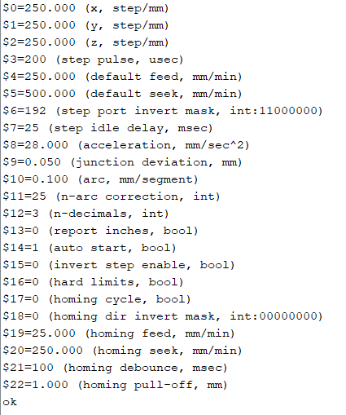
GRBL Settings.
With these settings and DQ542MA set to 400 pulse/rev, one 360 degree revolution of the motor is 6.4 x units.

Slide 24
Experiment 1 – move motor forward 1 complete revolution, and back 1 complete revolution, and measure the quad decoder count.
Result: VERY reproducible!
Max error = 4/2000 = 0.2% (4 pulses/2000)
Missed pulse
Missed pulse

Slide 25
Experiment 2 – move motor forward 1 complete revolution, in 26 steps of ~x=0.25, and then back in 1 step of x=6.4.
Result: Amazingly reproducible!
Forward and back with no pulse errors!

Slide 26
Experiment 3 – move motor forward x=1 in ten steps of 0.1 then back to 0.
Move motor to x=0.5 in steps of 0.05 then back to 0.
Result – no lost steps in both cases!
Amazing accuracy!

Slide 27
Experiment 4 – Based on previous data, 2000 encoder counts per rev = 312.5 steps/x (2000/6.4). Randomly picked some values, predicted what the encoder should count, and then compared to what it did count.
Result – Within 1 pulse of predicted value!! Fantastic!
This could definitely be used to check for lost steps or motor stalls +/- (4 pulses / 2000 (rev))

Slide 28
Check out this an other fun projects at: https://scienceelectronicsfun.com/
Code for ‘8051 is available:
https://scienceelectronicsfun.com/checking-the-accuracy-of-a-motor-encoder/

