Slide 1
Expand your mind… and IO ports! With Microchip’s Port Expander Chip!
What? What?

Slide 2
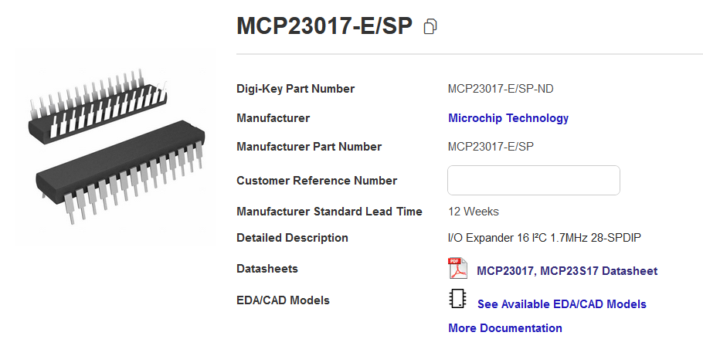
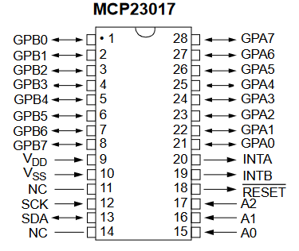
The MCP23017 gives you 2 extra 8 bit ports – useful for pin hungry devices like 7 seg displays and LCDs –
MCP23017 = configured using I2C
MCP23S17 = configured using SPI

Slide 3
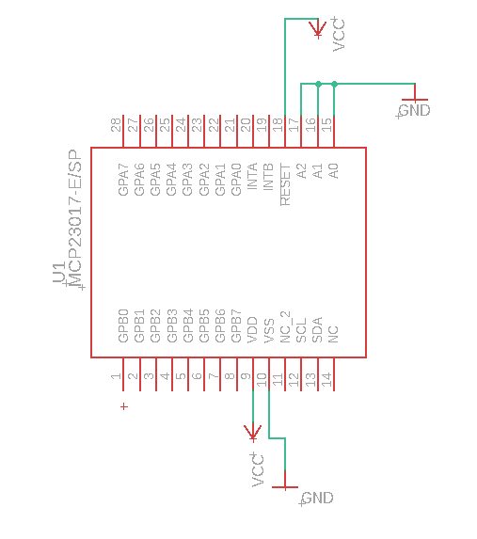
Interrupt
Reset* Active Low
A0, A1, A2 set address, here ‘000’
Allows up to 8 unique chips on one bus! That’s 16 8-bit ports!
PORT A
Simple operation
A0, A1, A2 GND = Address 0
Reset = 5V
VSS = GND
VDD = 5V
I2C pins connect to your microcontroller
PORT B
I2C pins

Slide 4
The ICON REGISTER
POWER UP: When the chip first powers up, an important register, ICON (I/O Configuration Register), has a “BANK” bit set to 0 (Bank 0). This allows flexibility in how the chip’s registers are addressed. For example, if ICON.BANK = 0, the input/output states (“IODIR”) of PORTS A and B are set by writing to MCP23017 address 00h and 01h. If you’d rather all A registers are grouped together 00h-0Fh then you can set ICON.BANK = 1.
IODIR = Direction; 1 = input, 0 = output

Slide 5
Configuring the MCP23017 for simple output
When the chip powers up, IODIR registers are set to ‘1111 1111’, i.e. both ports are set for input.
IODIR = Direction; 1 = input, 0 = output
So, configuring both ports to output requires setting IODIR A and B to ‘0’.

Slide 6
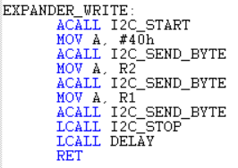
Configuring the MCP23017 for simple output
I2C Interfacing
So, configuring both ports for output requires:
Write = 0, read = 1.
Start
Data Stop

Slide 7
Configuring the MCP23017 for simple output
I2C Interfacing

Slide 8
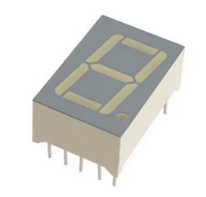
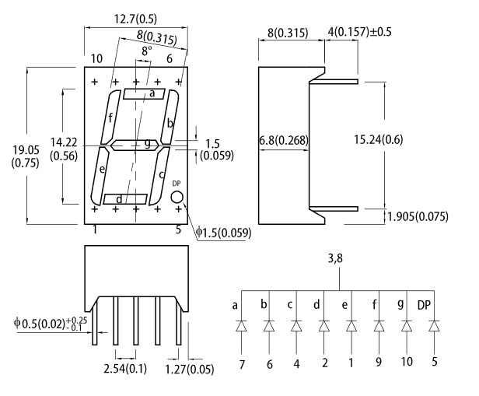
Interfacing with a 7-segment display
0 | a,b,c,d,e,f |  |  | 00111111
1 | b,c | 6,4 |  | 00000110
2 | a,b,g,e,d | 7,6,10,1,2 |  | 01011011
3 | a,b,g,c,d | 7,6,10,4,2 |  | 01001111
4 | f,g,b,c | 9,10,6,4 |  | 01100110
5 | a,f,g,c,d | 7,9,10,4,2 |  | 01101101
6 | a,f,g,e,c,d | 7,9,10,1,4,2 |  | 01111101
7 | a,b,c | 7,6,4 |  | 00000111
8 | a,f,b,g,e,d,c | 7,9,6,10,1,2,4 |  | 01111111
9 | a,f,b,g,c,d | 7,9,6,10,4,2 |  | 01101111
A | a,f,b,g,e,c | 7,9,6,10,1,c |  | 01110111
B | f,g,e,c,d | 9,10,1,4,2 |  | 01111100
C | a,f,e,d | 7,9,1,2 |  | 00111001
D | b,g,e,c,d | 6,10,1,4,2 |  | 01011110
E | a,f,g,e,d | 7,9,10,1,2 |  | 01111001
F | a,f,g,e | 7,9,10,1 |  | 01110001
 | PORT
 | 0-0-0-0-0-0-0
 | g-f-e-d-c-b-a
754-1467-5-ND
Coded port pins as shown in above table; these codes will produce the character in the left column. For example, to make a ‘1’ requires lighting ‘b’ and ‘c’ segments, or sending ‘00000110’.

Slide 9
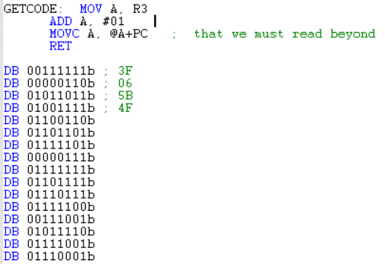
Indexed Addressing with Program Counter
Call function GETCODE with R3 containing the value you want to display.
Upon return, accumulator will be loaded with the correct code to display the character.
MOVC will move a byte from code or program memory to the accumulator; this mode of addressing uses the accumulator + PC as an index.
When MOVC instruction is executed, PC will point to RET; to skip past this and access correct element from the data table, pointer needs to be incremented by ‘1’ (ADD A, #01).
PC+1 points here when exec MOVC instruction.
So, calling GETCODE with R3 = 1:
MOV A, R3 ← Loads Acc with 1.
ADD A, #01 ← increments ACC so @A+PC skips ‘RET’
MOVC A, @A+PC ← If A originally loaded with ‘1’, will increment to ‘2’, now @A+PC skips to the 2nd element of the data table (‘0000110’) which codes for ‘1’ on the 7 seg.

Slide 10
Overview of Code: MCP23017 I2C 7seg.a51
“MAIN”
For each chip (#1-Add ‘000’, #2-Add ‘001’)
Send ‘0’ to DIRA and DIRB to make these ports OUTPUT.
Send ‘0’ to GPIOA and GPIOB to initialize outputs to ‘0’ (off).
“MAINLOOP”
R3 holds current hex digit 0-F.
Write this to each of one of the four 7 segment displays
Increment, reset counter when reaches “10”.

Slide 11
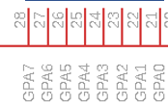
Wiring
Common ground
‘8051
SCL EQU P2.0 ; clock
SDA EQU P2.1 ; data
3.3k
GND
NC
A(7)
B(6)
C(4)
F(9)
D(2)
G(10)
E(1)
Kingbright pins
GPIO Port on
MCP23017

Slide 12
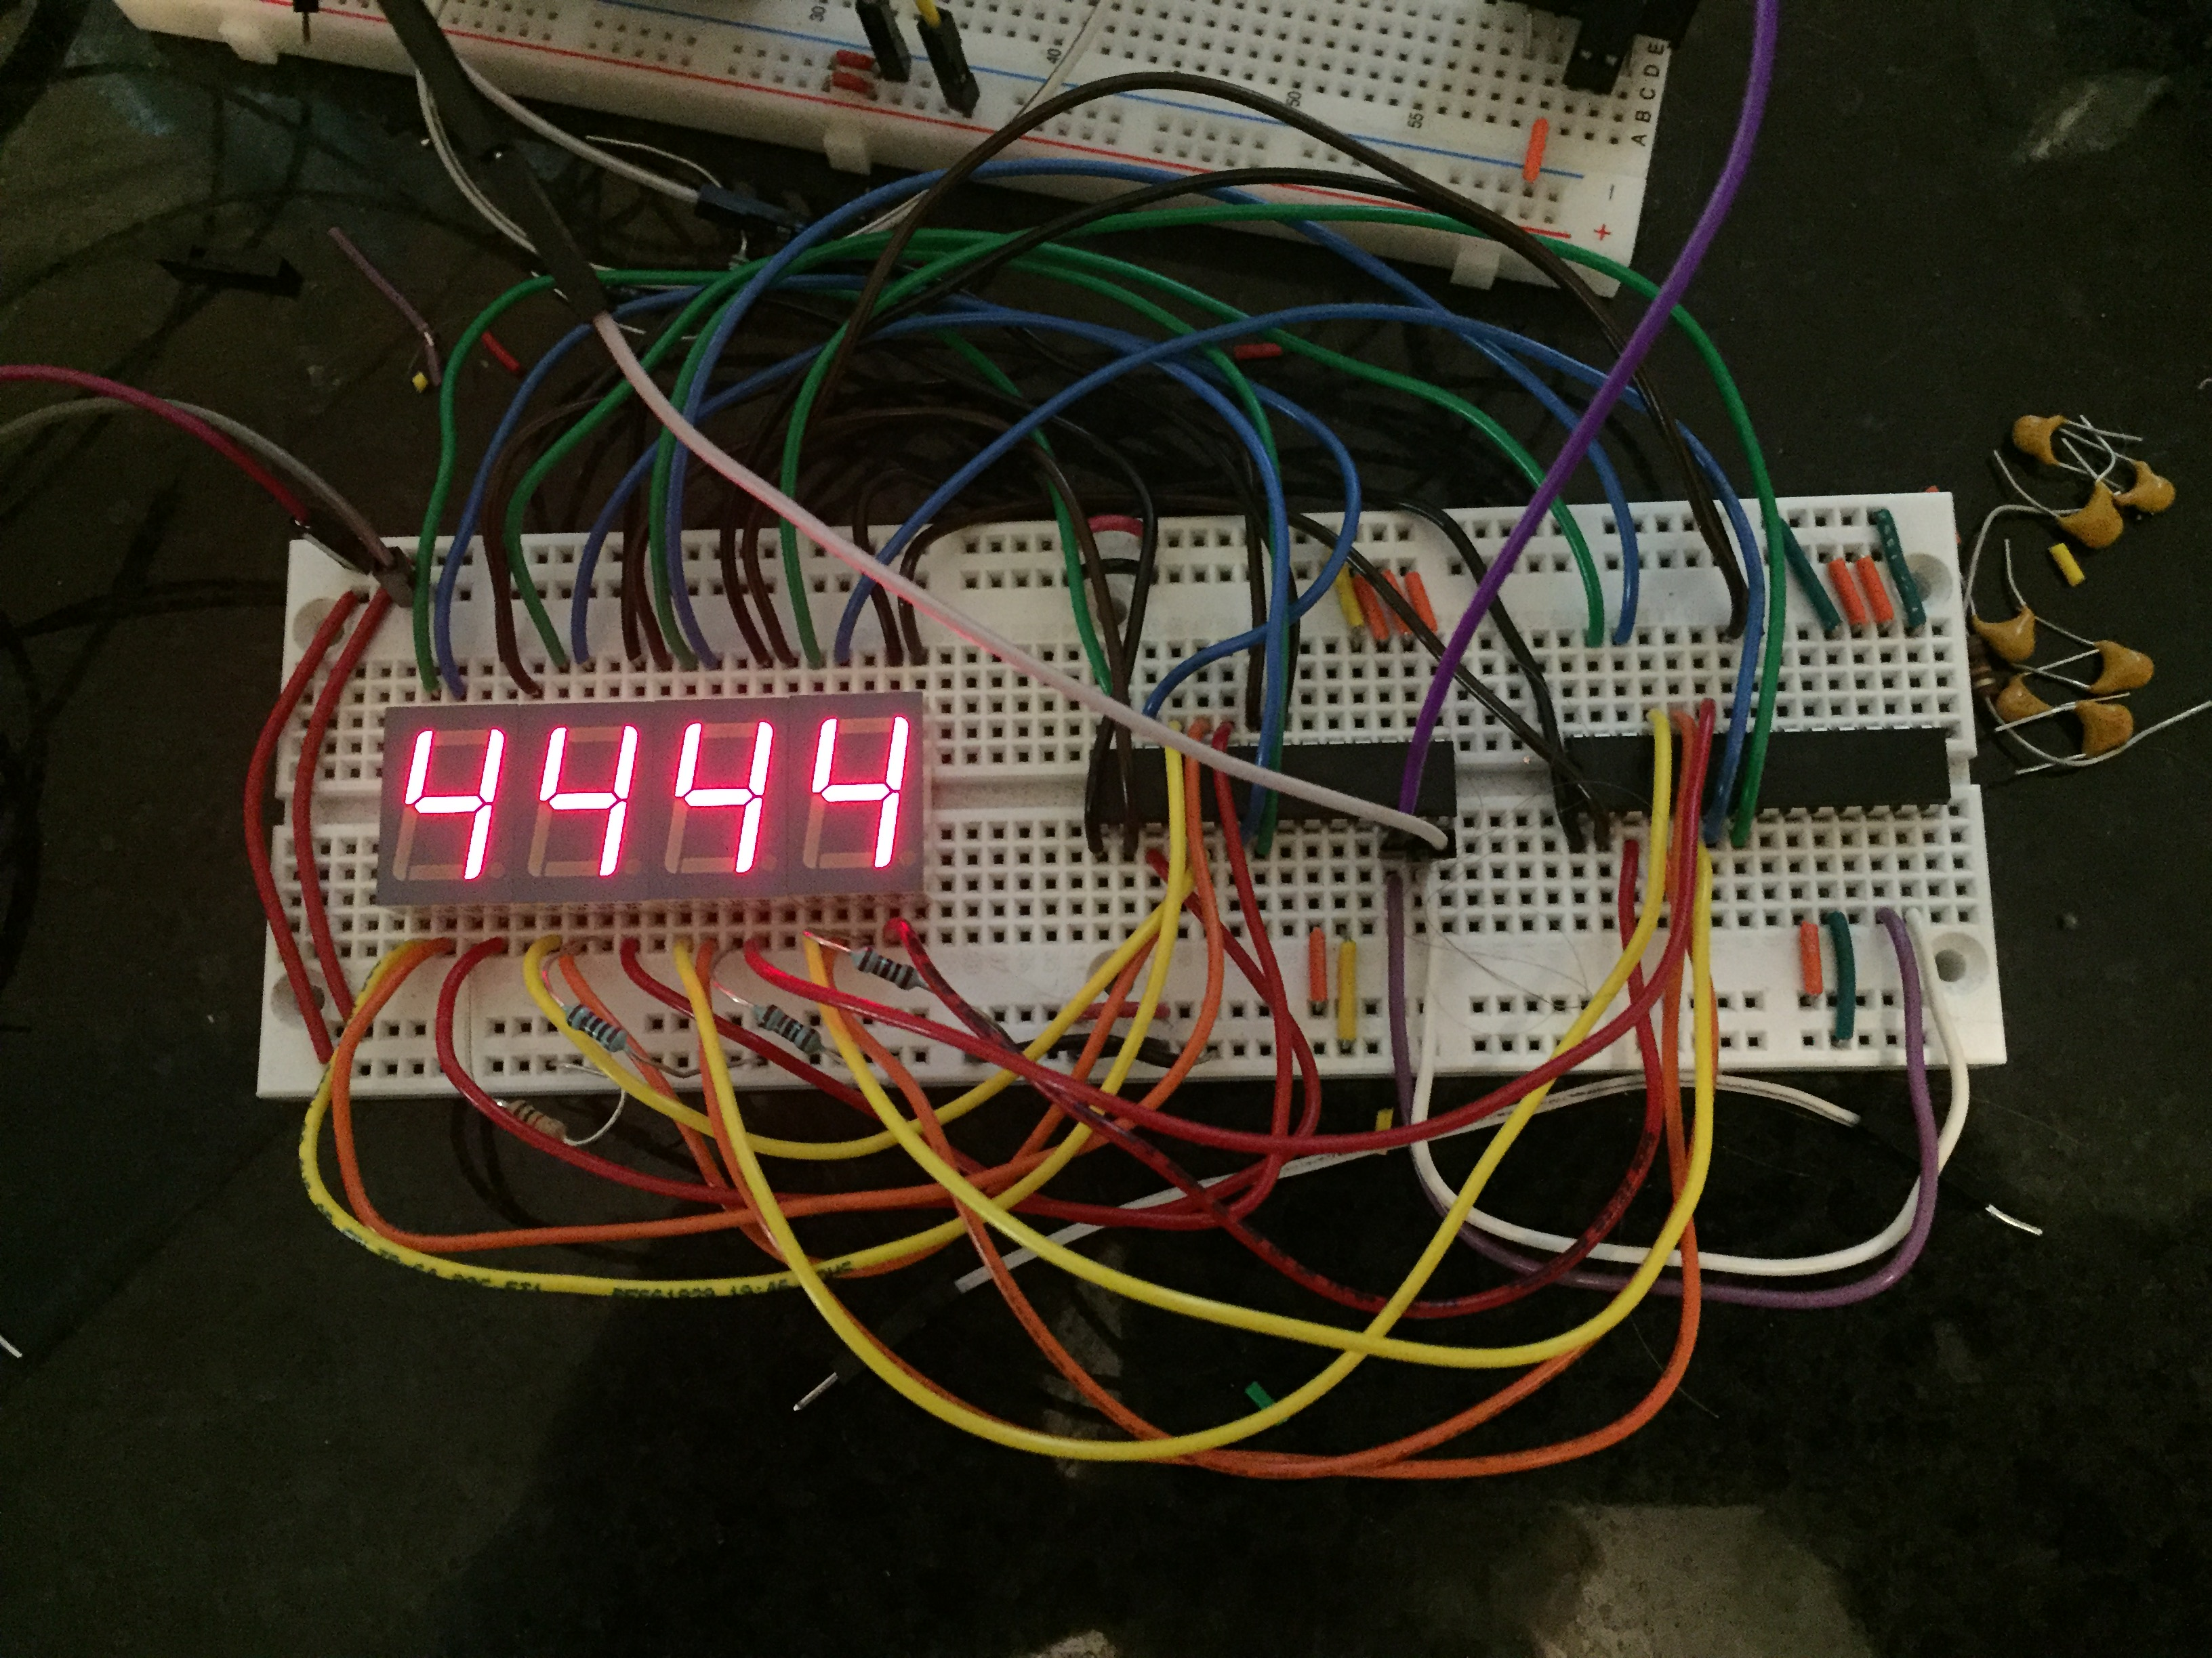
C8051F10 uses two MCP23017 to control 4 7-seg displays.
Future tutorials will show pin reading (input) and interrupt configuration!

