Slide 1
I2C Read/Write with EEPROM
More 8051 Fun!

Slide 2
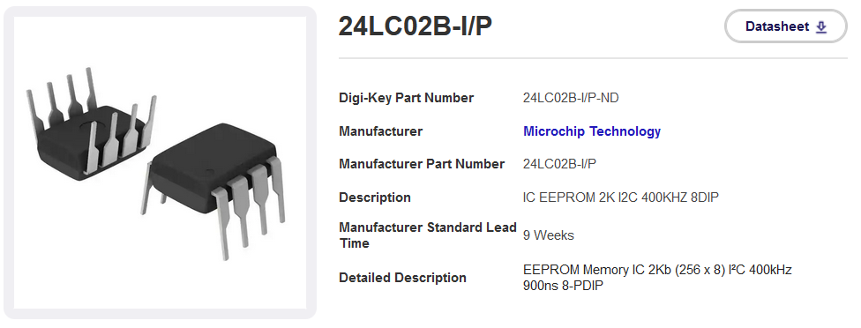
Goal: Perform WRITE and READ operations on small EEPROM chips using I2C

Slide 3
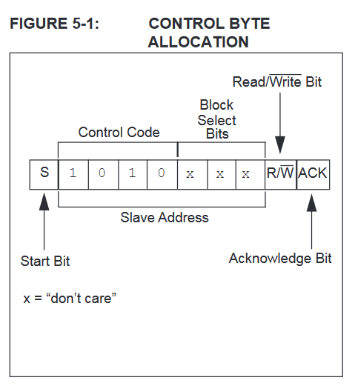
First, some background info from the data sheet
http://ww1.microchip.com/downloads/en/DeviceDoc/24AA02-24LC02B-24FC02-Data-Sheet-20001709L.pdf
24LC02B-I/P-ND
IC EEPROM 2K I2C
So, to write, send start bit, then 10100000 for a write, then send/read ACK.
Read would be 10100001.

Slide 4
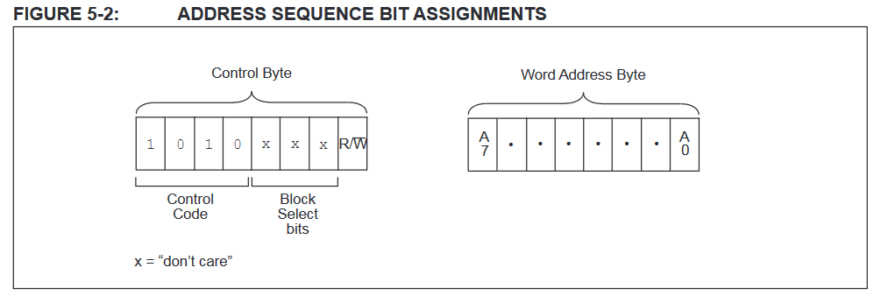
Word address = address of byte on chip. A7= MSB.

Slide 5
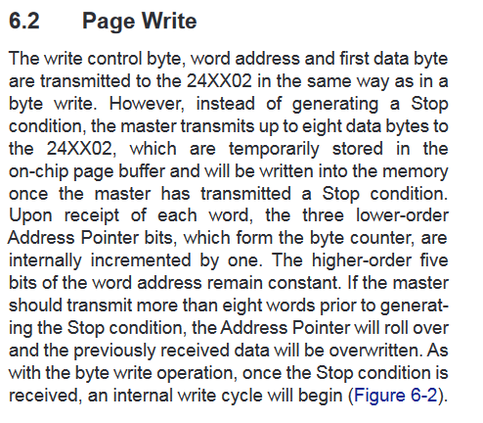
A0
This is how to send a single data write. Send start, write command, address, the data, and then stop.
You can send up to eight bytes at a time, but keeping it simple here, one byte at a time.

Slide 6
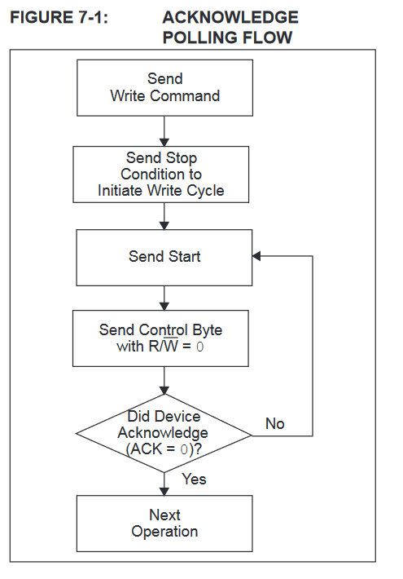
When writing multiple bytes, they recommend polling to check if the device is busy from a previous write. I can see why after playing around – it takes awhile to perform the write operation – on the order of several milliseconds.
So, to maximize throughput, you should implement their recommended algorithm, which sends an ACK as soon as its ready.
For this tutorial, I just included a sufficient delay between write commands.

Slide 7
There are three types of reads that can be done, current, random, and sequential. Current just reads the last address in the address register. A random read, demonstrated here, allows you to set the address register and then read its value. You can also read a stream of bytes in a sequential read.

Slide 8
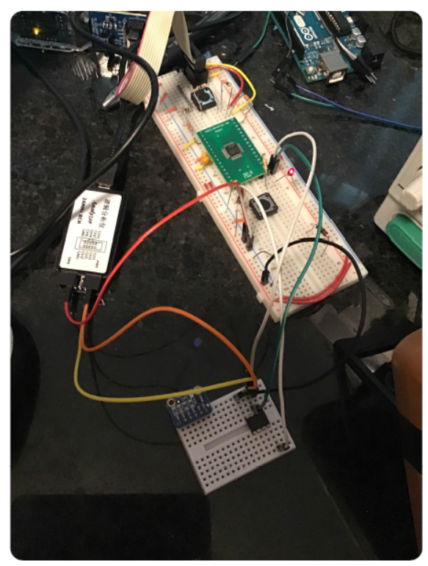
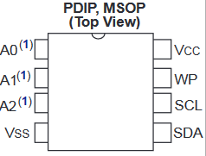
Setup
8051
SCL = P0.0
SDA = P0.1

Slide 9
Byte writing illustrated with Logic Analyzer.
Write location 0x00 value “E1”
Write location 0x00 value “23”

Slide 10
Byte reading illustrated with Logic Analyzer.
Read location 0x00 – returns “E1”
Read location 0x01 - returns “23”

Slide 11
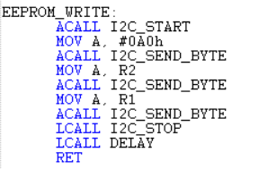
Code highlights - write
EEPROM Write uses EEPROM_WRITE function; first setup value to write, and address to write to
This is the write function – calls I2C_Start, sends write command, sends address, then sends data to write, and then stops.

Slide 12
Code highlights - read
Load R2 with address, then call EEPROM_READ – byte read will be stored in ACC.
Read function sends I2C start, sends write command, sends address to address reg, reinitializes I2C and sends another start signal, then sends read command and reads the byte from the EEPROM over I2C. Then a stop signal is sent.

