Slide 1
A tutorial on I2C

Slide 2
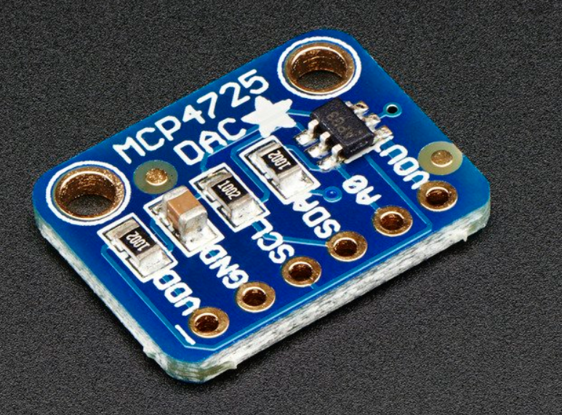
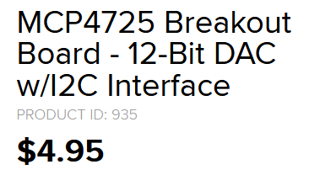
The Goal
From the 8051, communicate with an MCP4725 DAC (Adafruit breakout board).
Commands
Address = 0x62
Write to DAC = 0x40
Then send 2 bytes of data for value.
https://www.adafruit.com/product/935
https://learn.adafruit.com/mcp4725-12-bit-dac-tutorial
https://learn.adafruit.com/mcp4725-12-bit-dac-tutorial/using-with-arduino

Slide 3
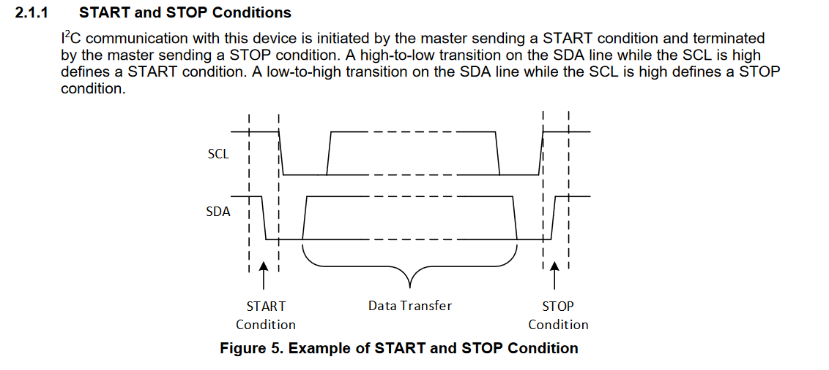
Some good reading – A Document from Texas Instruments
http://www.ti.com/lit/an/slva704/slva704.pdf?&ts=1589762906285

Slide 4
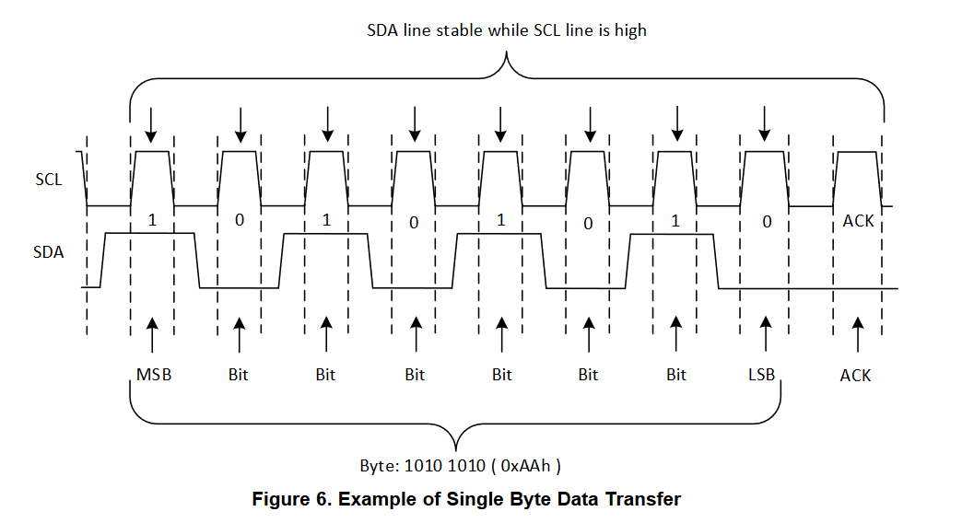

Slide 5
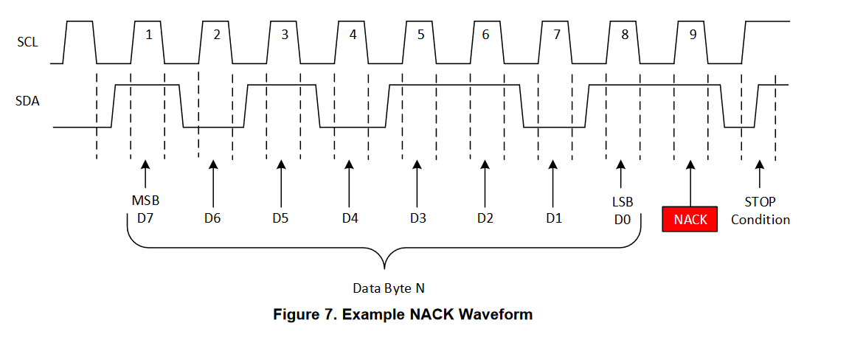

Slide 6
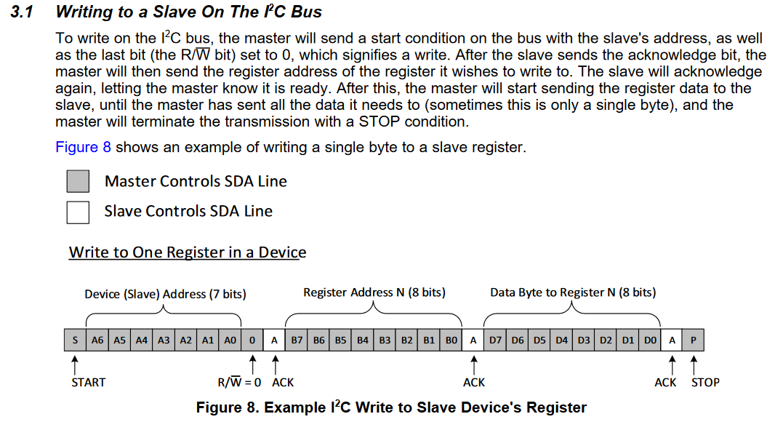

Slide 7
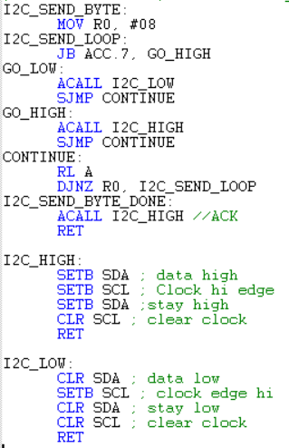

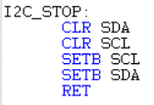

A simple I2C Protocol for the 8051
I2C send byte – writes byte of data + ACK to slave
I2c test 9.a51
I2C start – sends start condition
“high to low transition on the SDA line while the SCL is high”
I2C stop – sends stop condition
Low-to-high on SDA while SCL high defines STOP condition.
I2C pin assignments

Slide 8
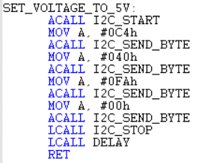
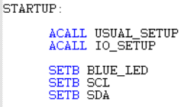
Interacting with the MCP4725 breakout board from the 8051 using I2C
Must do the following ---
I2C start
I2C send byte (address – 7 bits, 1 bit W*/R)
I2C send byte (command)
I2C send byte (data byte 1)
I2C send byte (data byte 2)
Address = 0x62 = 1100010 + W*/R = 1100010 + 0
This = C4 = 11000100, so to send WRITE* to address 0x62, send byte 0xC4.
Command = 0x40
Data = 0xFA, 0x00 for ‘4000’.
At startup, pull SCL, SDA high
So, to set voltage to 5V:
Address 0x62 + write bit (LSB)
Bring SCL and SDA high to start
Command 0x40 (write to DAC)
Data, 8 high bits
Data, 4 low bits

Slide 9
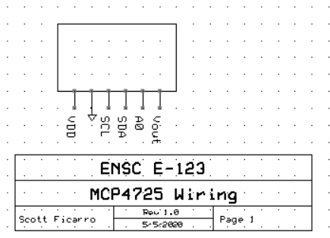
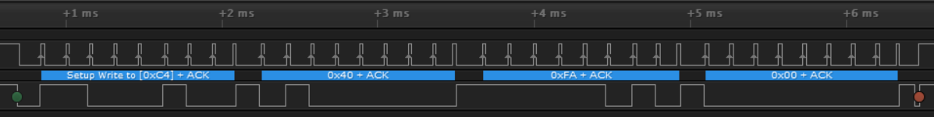
MCP4725
Wiring
C8051F410
SCL P0.0
SDA P0.1
LED P0.4
Saleae Logic Analyzer software; SCL channel 0, SDA channel 1
SCL
SDA
ADDRESS + WRITE
COMMAND
DATA BYTE 1
DATA BYTE 2

